Slide 1


Air Force Institute of Technology
NENG 791 – Proliferation of Weapons of Mass Destruction
Nuclear Fuel Cycle Overview
LTC Buck O’Day
E d u c a t i n g t h e W o r l d ’s B e s t M i l i t a r y

Slide 2
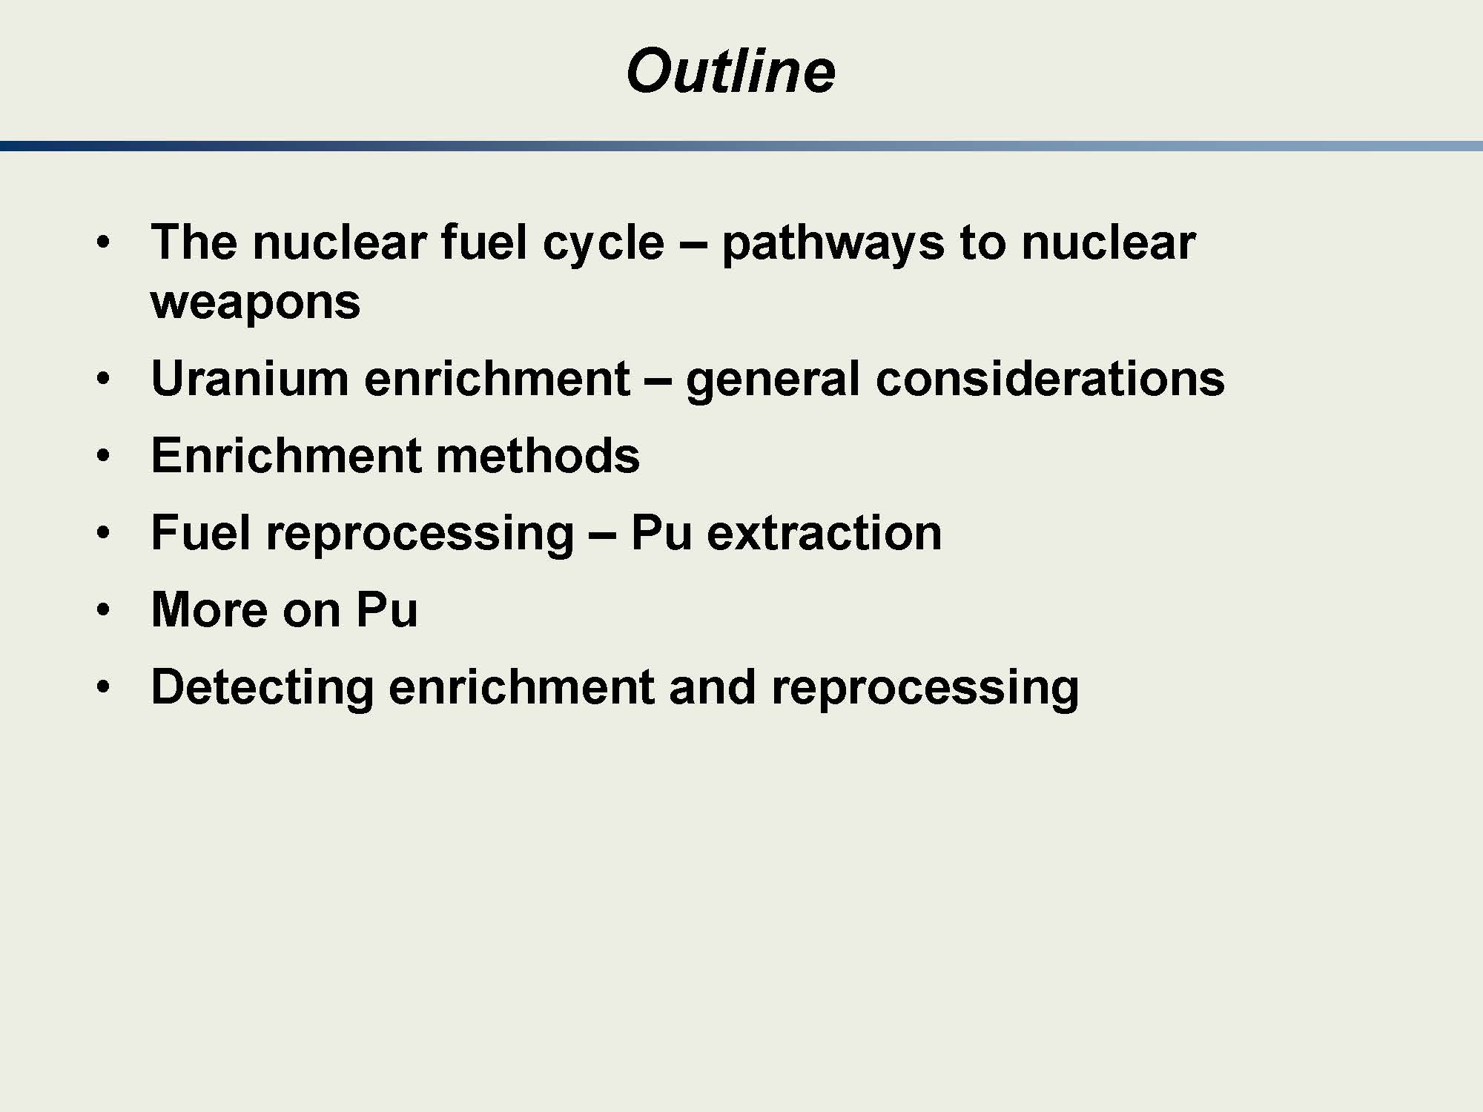
Note the shaded slides (like this one) were taken from a series of courses developed by an academic collaboration (MIT, PSU, & Texas A&M) with funding from the NNSA through the Global Threat Reduction Initiative to provide exportable nuclear security related courses to academic institutions for integration in their nuclear science and engineering programs.

Slide 3
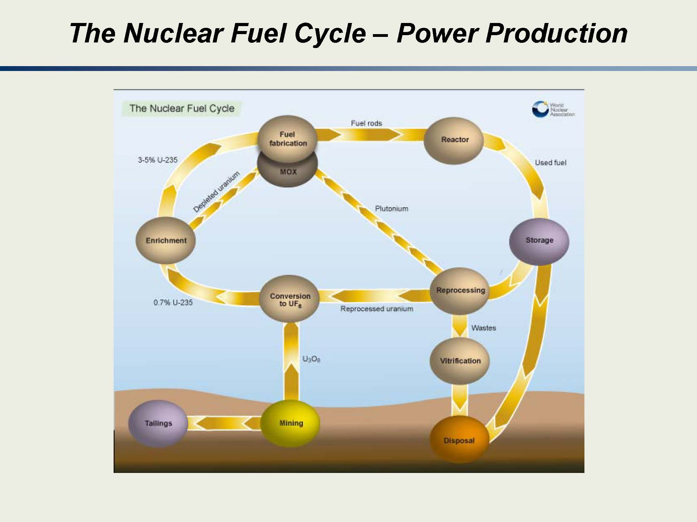
Notes:
You should have a basic understanding of the nuclear fuel cycle. I would suggest, rather than trying to “memorize” the fuel cycle, you think about it “logically,” i.e. from where the uranium starts to where it ends and what must be done in between.
Mining—basically getting the Uranium Ore out of the ground
Milling (not listed here)—changing it to a usable form.
Tailings—waste from the mining/milling operation
Conversion to UF6—taking the uranium to a form that can be used for enrichment
Enrichment—using physical or chemical processes to increase the number of 235U to 238U in the material
Depleted Uranium—has a lower 235U content (higher 238U content) than natural U. You may use this 238U to “breed” 239Pu (this is because 238U is fertile, meaning you can, through neutron capture, turn it into fissile 239Pu)
3-5% 235U—typical enrichments for Light-Water Reactors
Fuel Fabrication—placing the fuel in to form for use in the reactor
Fuel rods—designed to “contain” the fuel and subsequent fission products while used in the reactor
Reactor—you “burn” fissile material (there is some “breeding” or production of fissile material from fertile material also occuring)
Used Fuel—normally (in the US) stored on site
Storage—temporary holding of the material. This fuel is “hot” meaning it is both radioactive and, because it still has decaying fission products is still producing heat.
Disposal—final disposition of either un-reprocessed fuel (straight from storage) or reprocessed waste (long-live isotopes, short-lived isotopes) that has been vitrified (embedded in glass to prevent transport through the environment
Reprocessing—we’ll cover this more in later lectures but basically the point is to remove what is useful (fissile and fertile material) from spent fuel for (1) use in reactor fuel or (2) in a weapon (i.e. 239Pu)

Slide 4
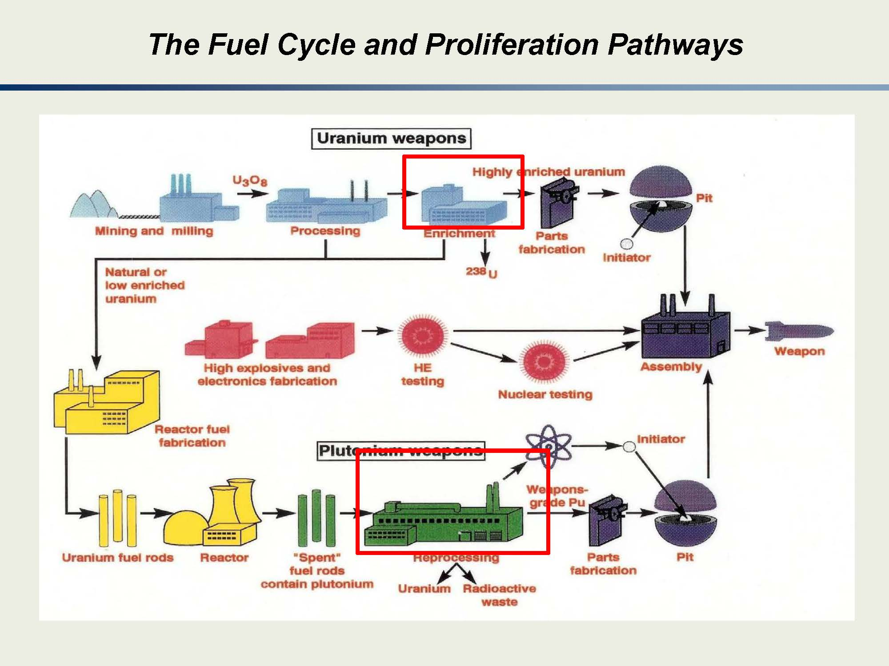
Notes:
A slightly different look at the fuel cycle here, which includes development of U and Pu weapons and the proliferation pathways.
Spend some time thinking about each portion of the fuel cycle and what “might” be an indicator of proliferation.
Obviously, there are non-traditional fuel cycle aspects here.
Pu weapons obviously come from reprocessing since the 239Pu is created from neutron capture in 238U and subsequent beta decay.
Note the portion in the middle, in red, which has components that are NOT in the normal fuel cycle. These are tale-tell signs of a weapons program.
Also not the parts fabrication and pit construction that occurs for both the U and Pu weapons development.

Slide 5
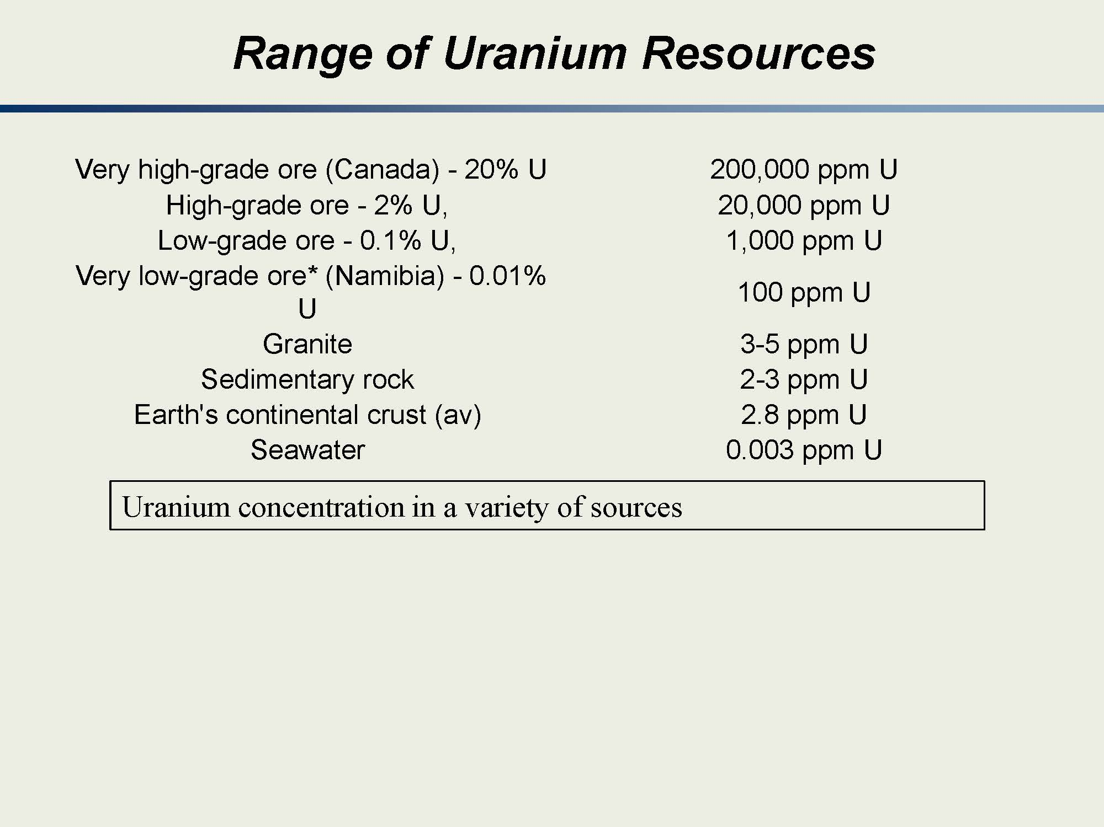
Notes:
There are Uranium resources throughout the world.
Why might higher grade ores be preferred? They are generally less expensive for mining operations.
One should note that even seawater has Uranium content, albeit at a very, very low concentration.
The key point is that Uranium is very widespread.

Slide 6
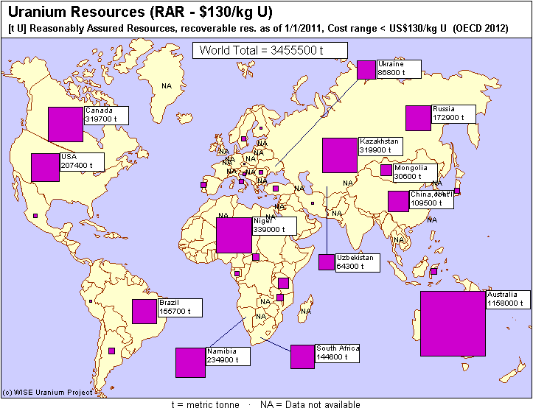
Uranium Ore Processing (1 of 2)
World Uranium Ore Resources
http://www.wise-uranium.org/uod.html
Notes:
This is a snapshot of known (reported) uranium resources.
While we might be happy to see that much of the reserves are in the US, Canada, and Australia, there are vast amounts of ore (known and unknown) throughout the world.
Even Iran recently reported that they have found their own reserves…
It should be noted that not all ores are “equal.” With this statement I am referring to more than just the ppm content of U. There are other materials that are found in the ore which, when trying to separate uranium, need to be separated.

Slide 7
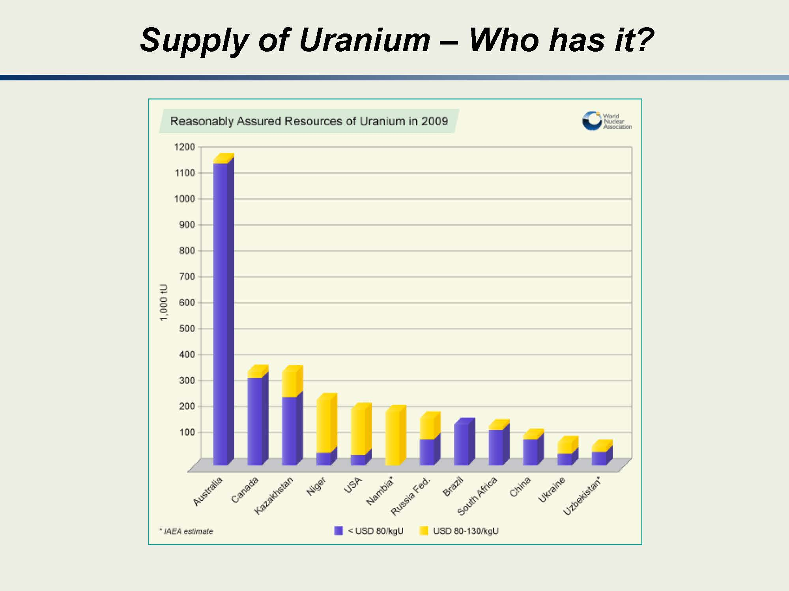
Notes:
Here’s a different look at the same kind of information…

Slide 8
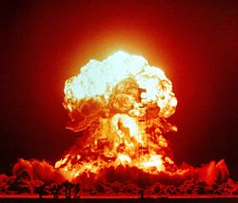
Uranium Ore Processing (2 of 2)
Mining and milling of natural uranium into yellowcake
Natural uranium contains only 0.7% U²³⁵
Crushed and dissolved using sulfuric acid
Solvent extraction or ion exchange
Treatment with ammonia
Heating and desiccation yields U₃O₈ (yellowcake)
Conversion of yellowcake into UF₆
Yellowcake heated to produce UO₂
Reactions with hydrogen fluoride to produce UF₆ (hex)
Enrichment of UF₆
Fuel fabrication
Reprocessing
Storage
Disposal
Export of yellowcake is not restricted by treaty
Notes:
Yellowcake is not restricted by treaty so it can be bought and sold…
We’ll cover enrichment in much greater detail later.
When you consider fuel fabrication, making the fuel for a reactor or for a weapon are two completely different things.
While I’ve lined through the last three steps it is only because we currently aren’t doing them.
President Carter decided on no reprocessing
While we had the Yucca Mountain site planned for ultimate storage and disposal, it has not been approved for use.

Slide 9
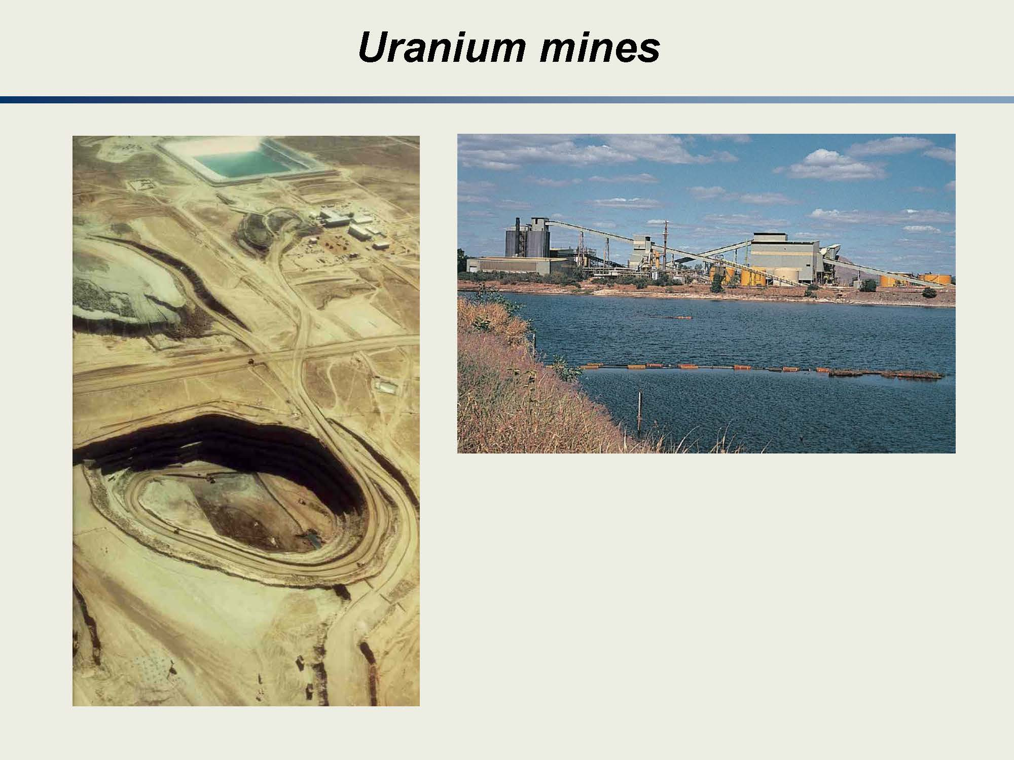
Notes:
We won’t go into detail on the mining and milling but here are a few graphics for your enjoyment!
What you see to the left is an “open” mine. Another type of mine is what we traditionally think of, which is digging into the side of a mountain.
To the right, you see a plant where milling takes place. It is not a small endeavor.

Slide 10
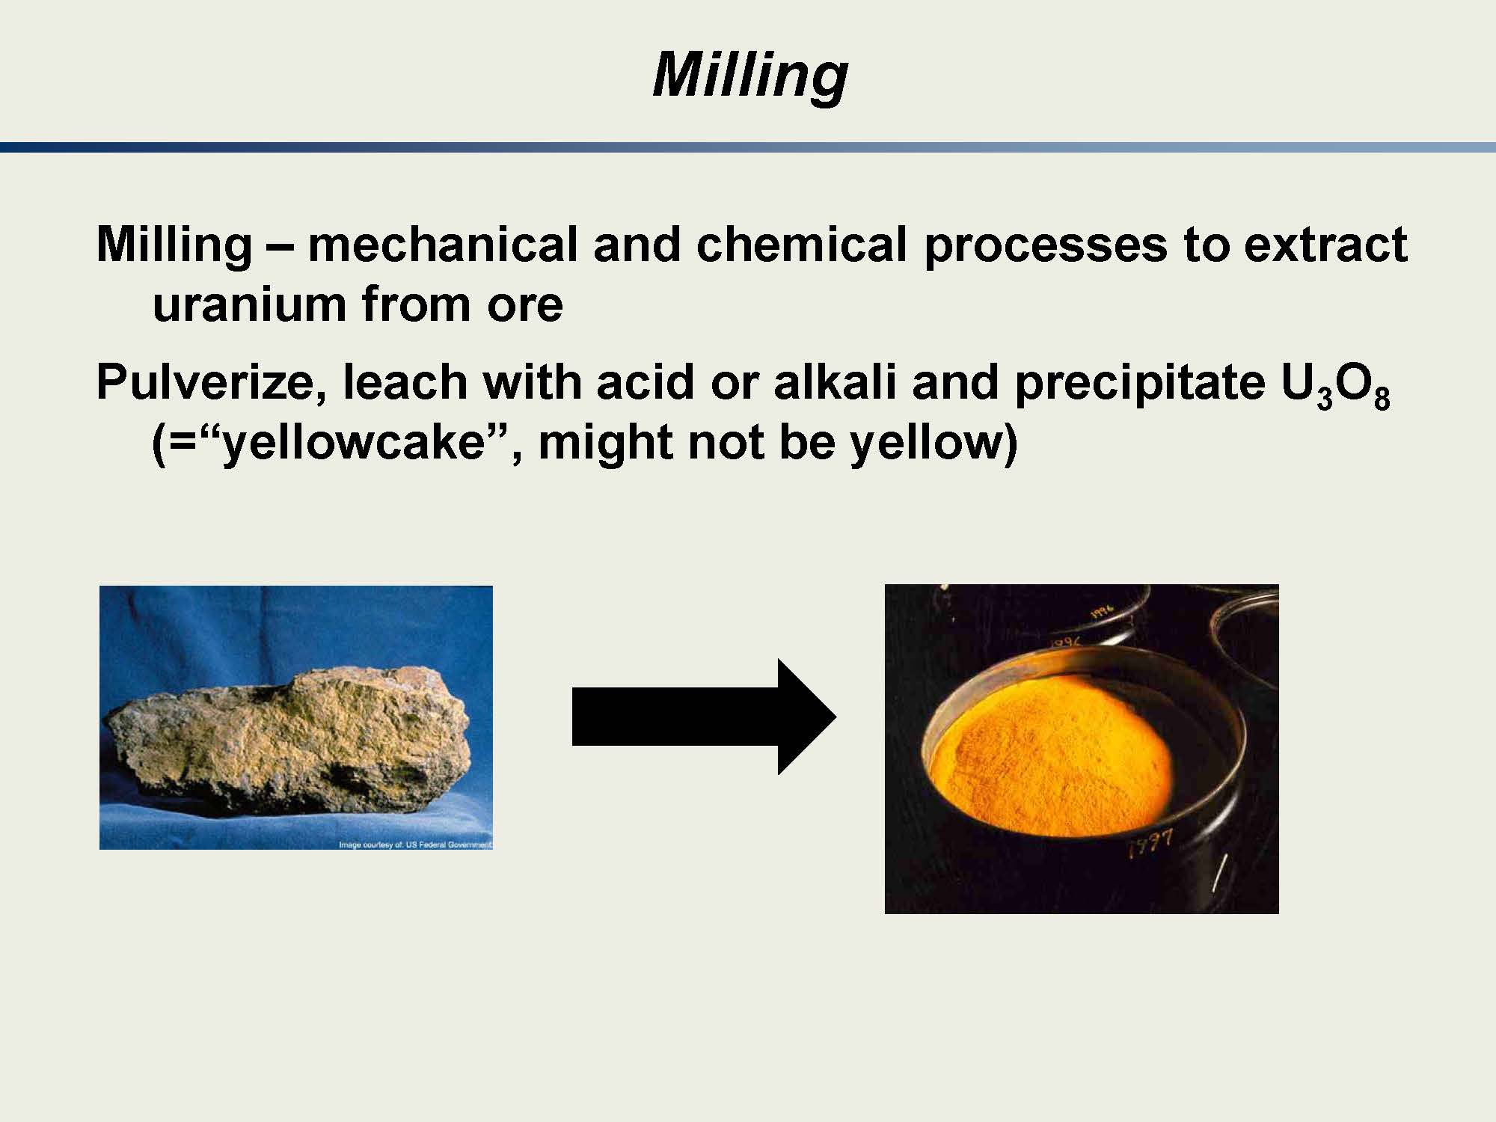
Notes:
Again, we won’t go into detail on the milling but the main point is you turn an ore (like we see on the left) into a product (see on the right) that can be used for processing.

Slide 11
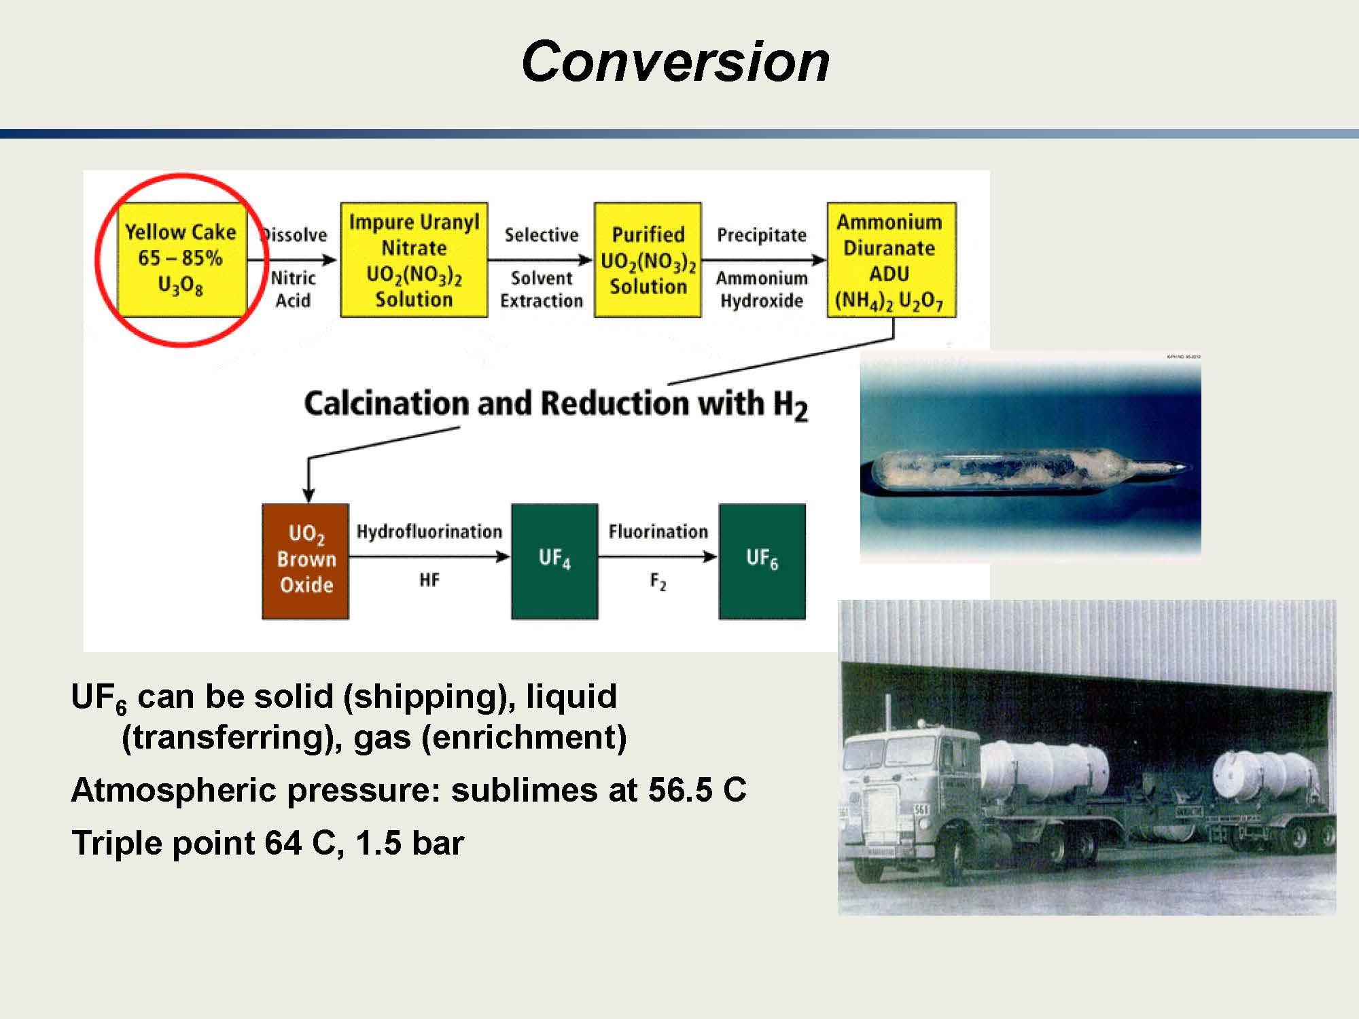
Notes:
In NENG 581 / 681 this is covered in more detail.
The main point is that you want to take the uranium and turn it into a form that you can use for enrichment.
As we will find out, UF6 is not a “nice” compound—it is very reactive.

Slide 12
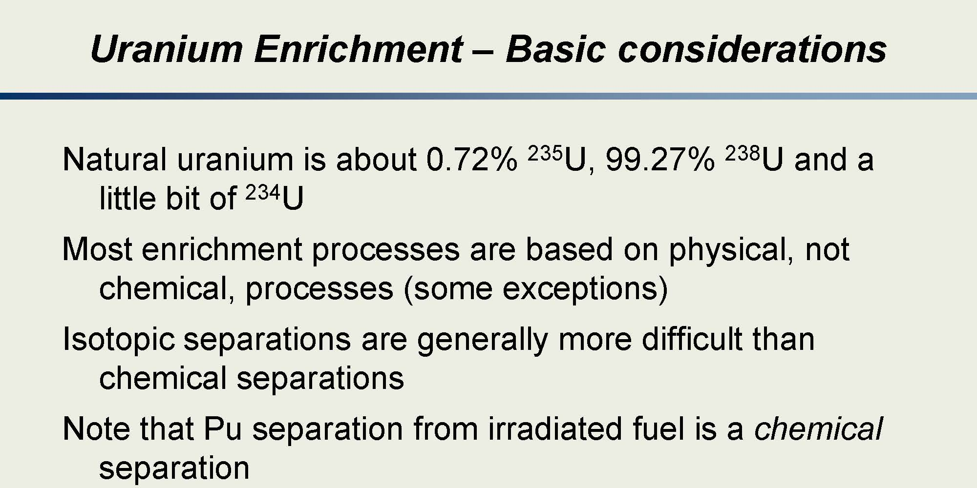
Notes:
When we go through the enrichment block of instruction, you will learn that we frequently use UF6.
We use UF6 because fluorine comes in a single stable isotope. Thus, when you combine it with Uranium, you have two molecules that have different masses which are attributed to the difference in the number of neutrons in 238 and 235U.
This opens a realm of possibilities on how we can enrich uranium. These possibilities use basic physics—like the Lorentz force, centrifugal force, or diffusion—to allow us to “enrich” the Uranium 235 content.
Thus, it is readily apparent that the “physics” of enrichment is quite well understood.
A key note on enrichment is that the more enriched in 235U the uranium is, the smaller amount of material that is required to have a critical mass.

Slide 13
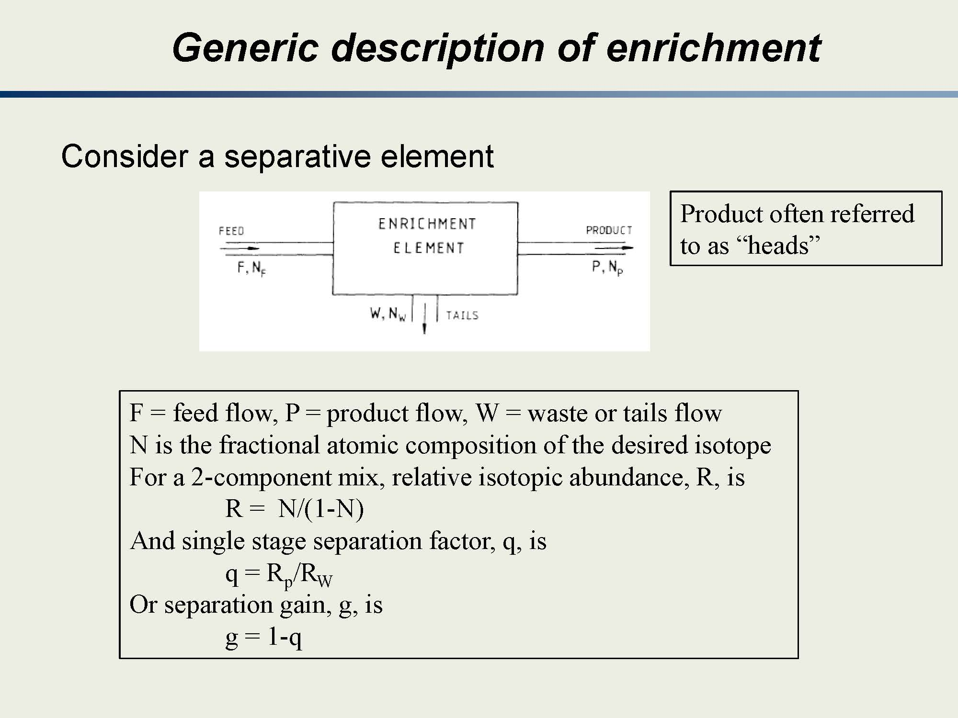
Notes:
Here is your first basic introduction to enrichment.
Here we use a “black” box that enriches the uranium.
The concept is that you take a “feed” in, it goes through an enrichment device that yields “tails” which have lower 235U content and “heads” which have a higher 235U enrichment.
The relative isotopic abundance is just a measure of the ratio of the desired isotope to other isotopes.
If you were to work through the algebra, you can determine the single stage separation factor.
“Gain” is an alternative way of looking at it.

Slide 14
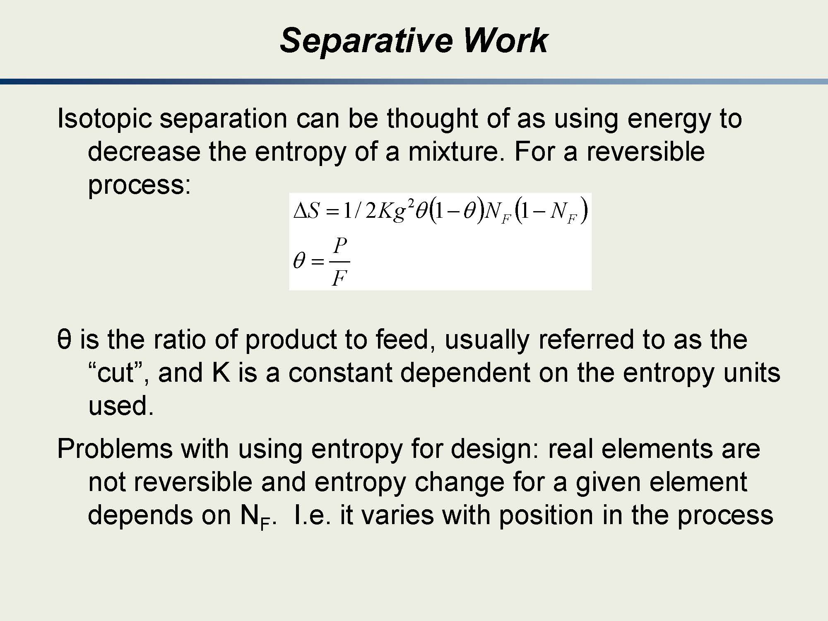
Notes:
Here we are looking at separative work as a means of decreasing the entropy of a mixture.
You don’t need to “memorize” this equation here. I’ll provide a more usable set of equations later.

Slide 15
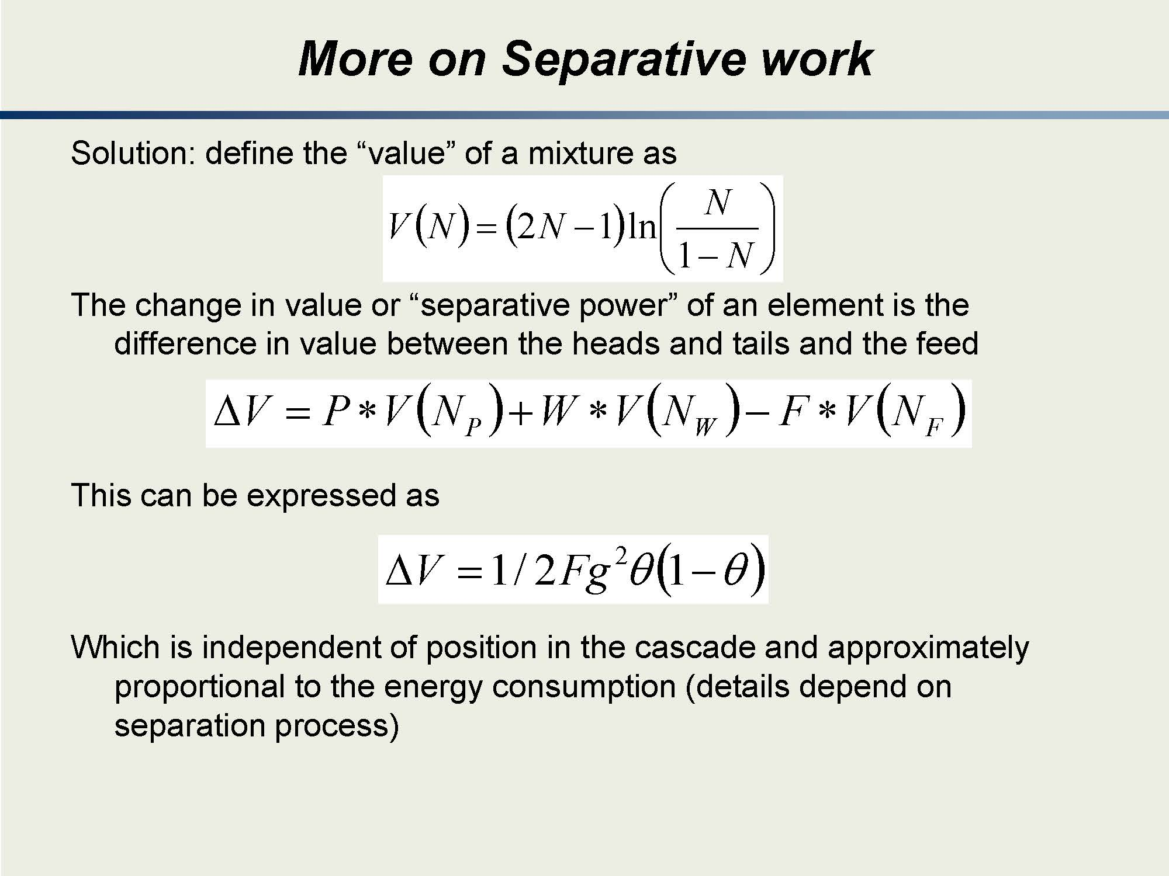
Notes:
The first equation here basically tells you that as you increase the fraction of 235U you have two competing factors.
Recall that N is the fractional composition of the desired isotope.
When we start off, N is very small and both the bracketed terms are negative.
Eventually, you get to a point (50%) where the first term is now positive and the second term is now positive.
This is one way of describing the “value” of the enrichment.
I don’t particularly like this way of looking at it but I thought you should be aware of it because some people do use it.
You will see later that as you increase enrichment, it becomes easier and easier (less work required) to reach higher levels of enrichment.

Slide 16
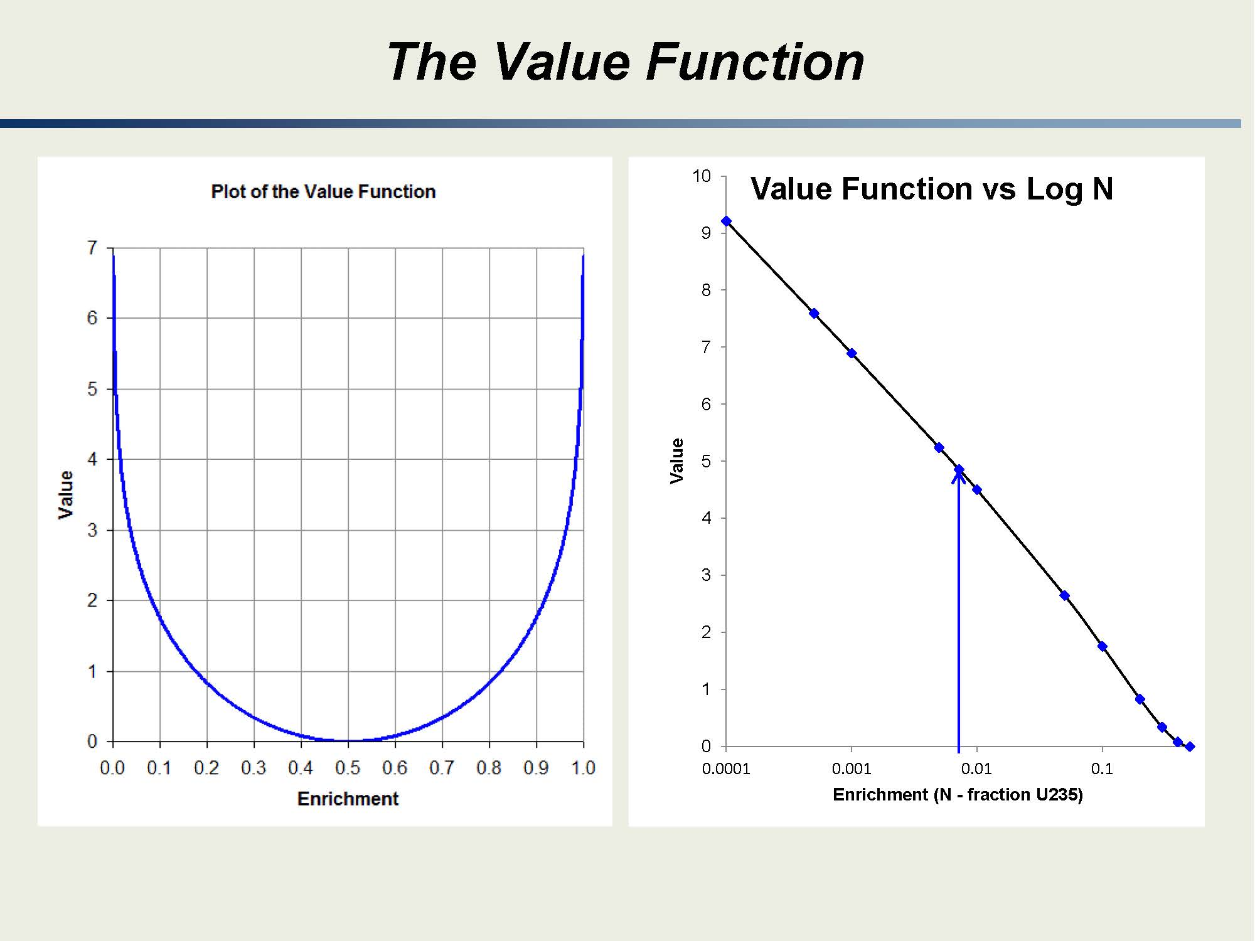

Slide 17
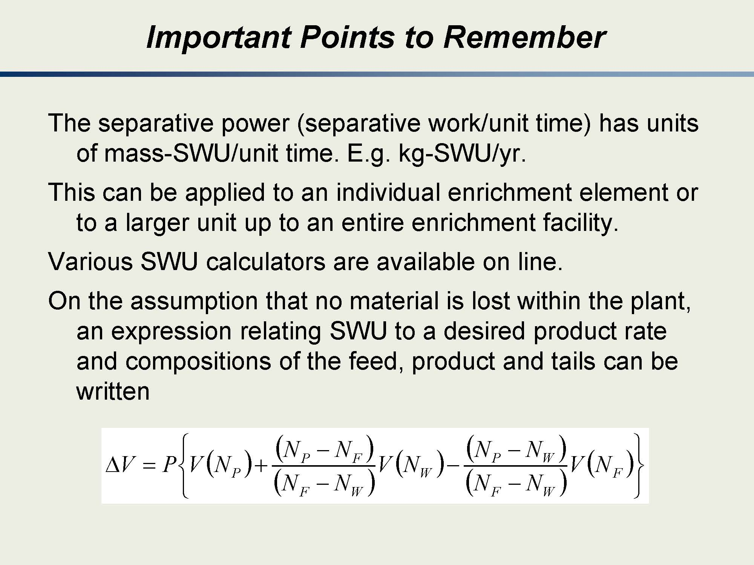

Slide 18
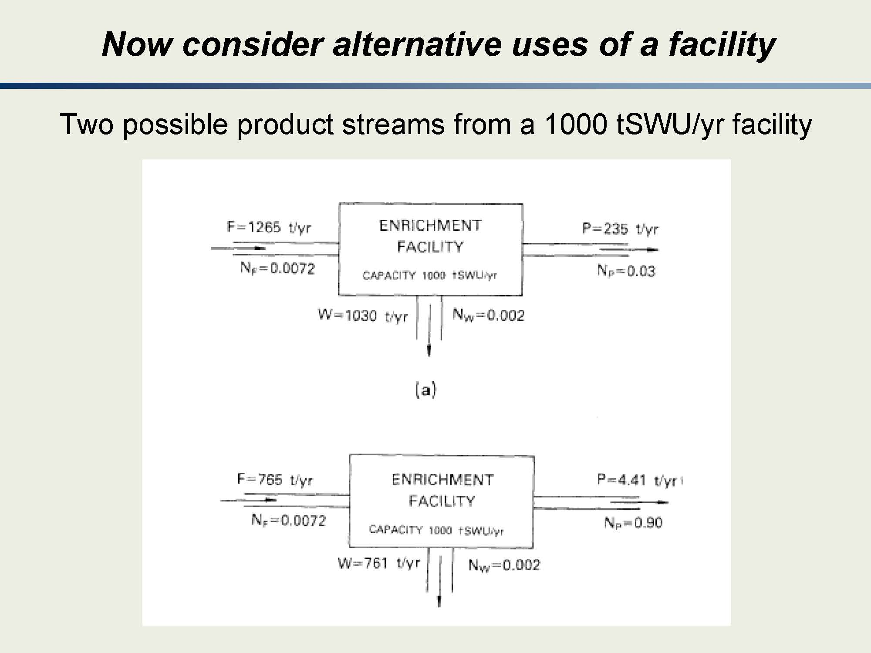
Notes:
The purpose of this graphic is to show you that for two enrichment facilities, with the same SWU/yr value, you can have completely different results.
Note the difference in feed is not that different (although it certainly is noticeable if you are tracking it) but the produce is vastly different.

Slide 19
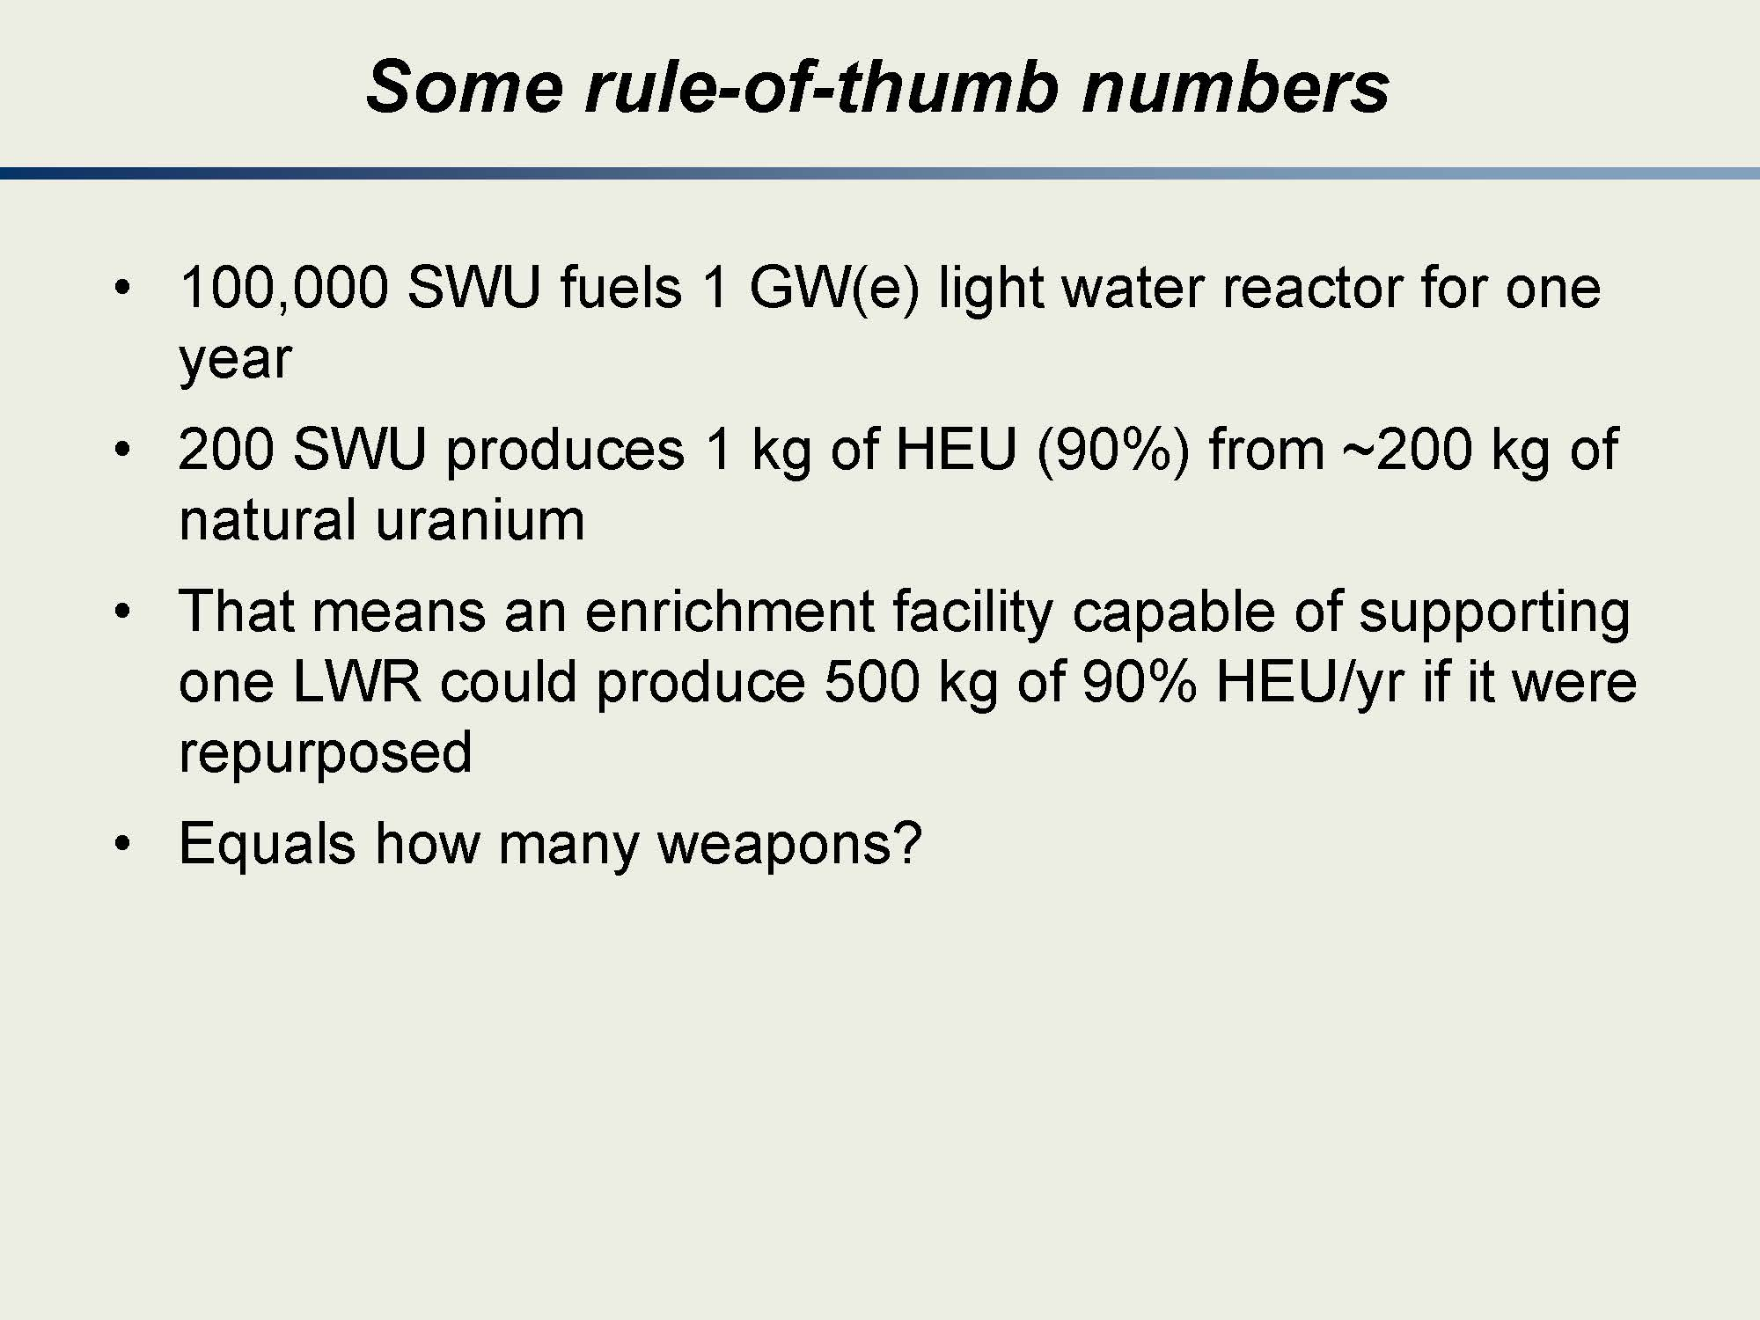
Notes:
These are some heuristics you might want to put in your kit bag for later use.
Of course, we’ll find out that having the number of SWUs is not the only important factor—you also have to have the right cascade which varies significantly depending on what you are doing.

Slide 20
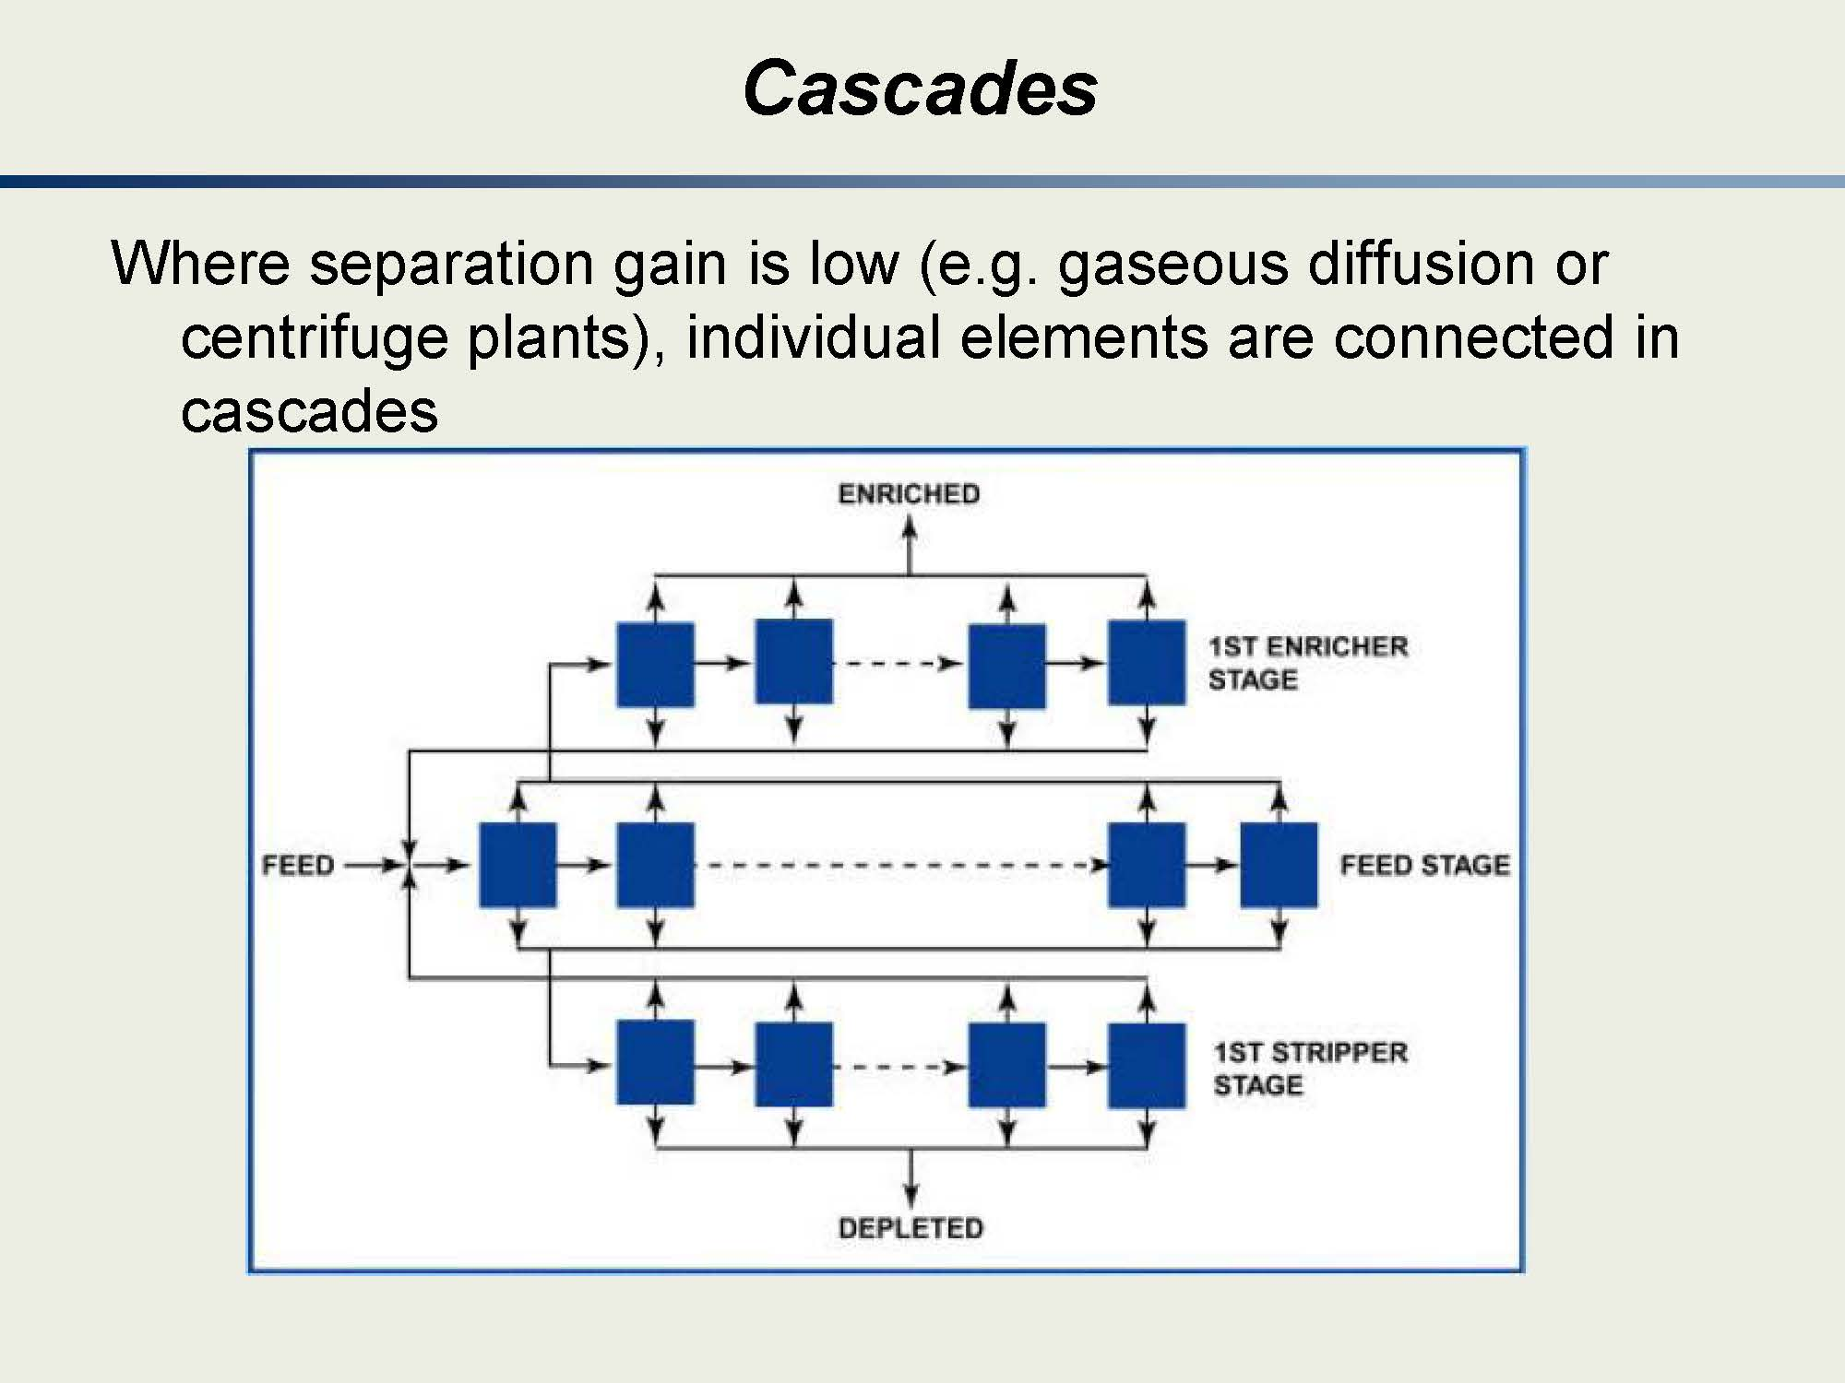
Notes:
Note how in the bottom stage, the waste (depleted) is not used but the product is used is the feed for the middle stage.
The product from the middle stage is used to feed the top stage and the waste is used to feed the first stage.
The idea is for have a waste from an upper stage that feeds a lower stage (so the waste has to equal to feed 235U enrichment) so you can optimize your use of uranium.

Slide 21
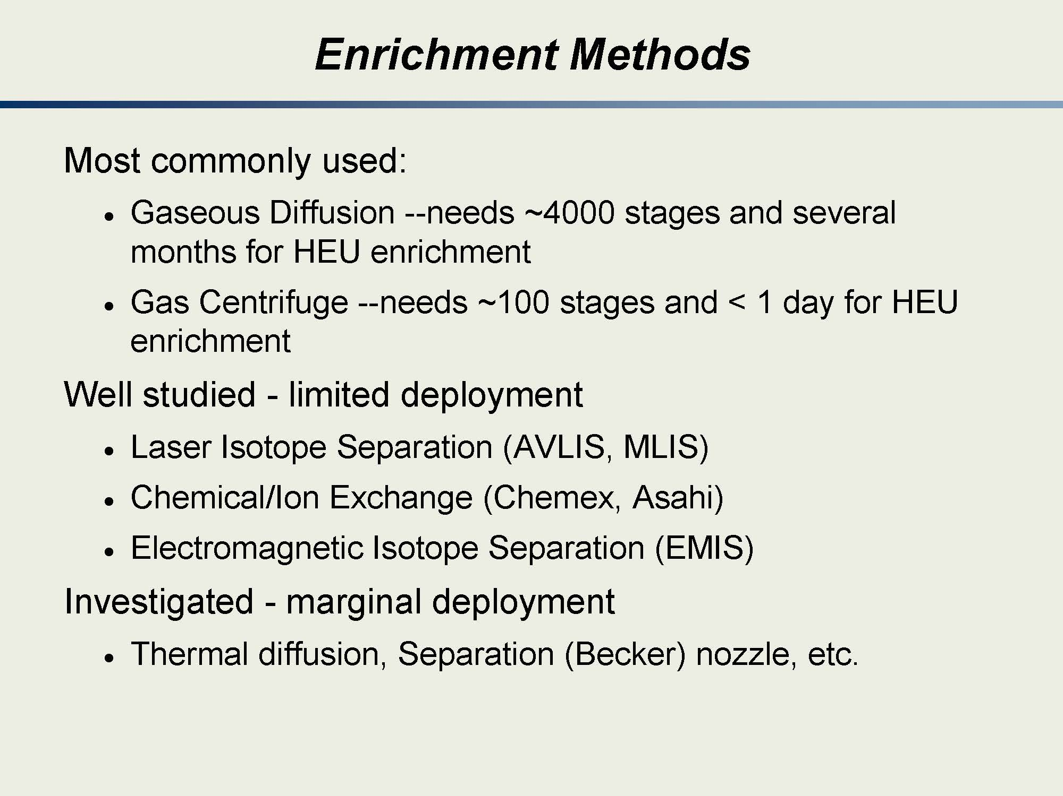
Notes:
In the following slides (which are hidden) you will get a brief overview.
Much of this will be covered in a subsequent lecture. These are provided to give you a “preview” of what is to come.
I won’t cover these hidden slides in class for this lecture as they will be addressed in more detail next time.

Slide 22
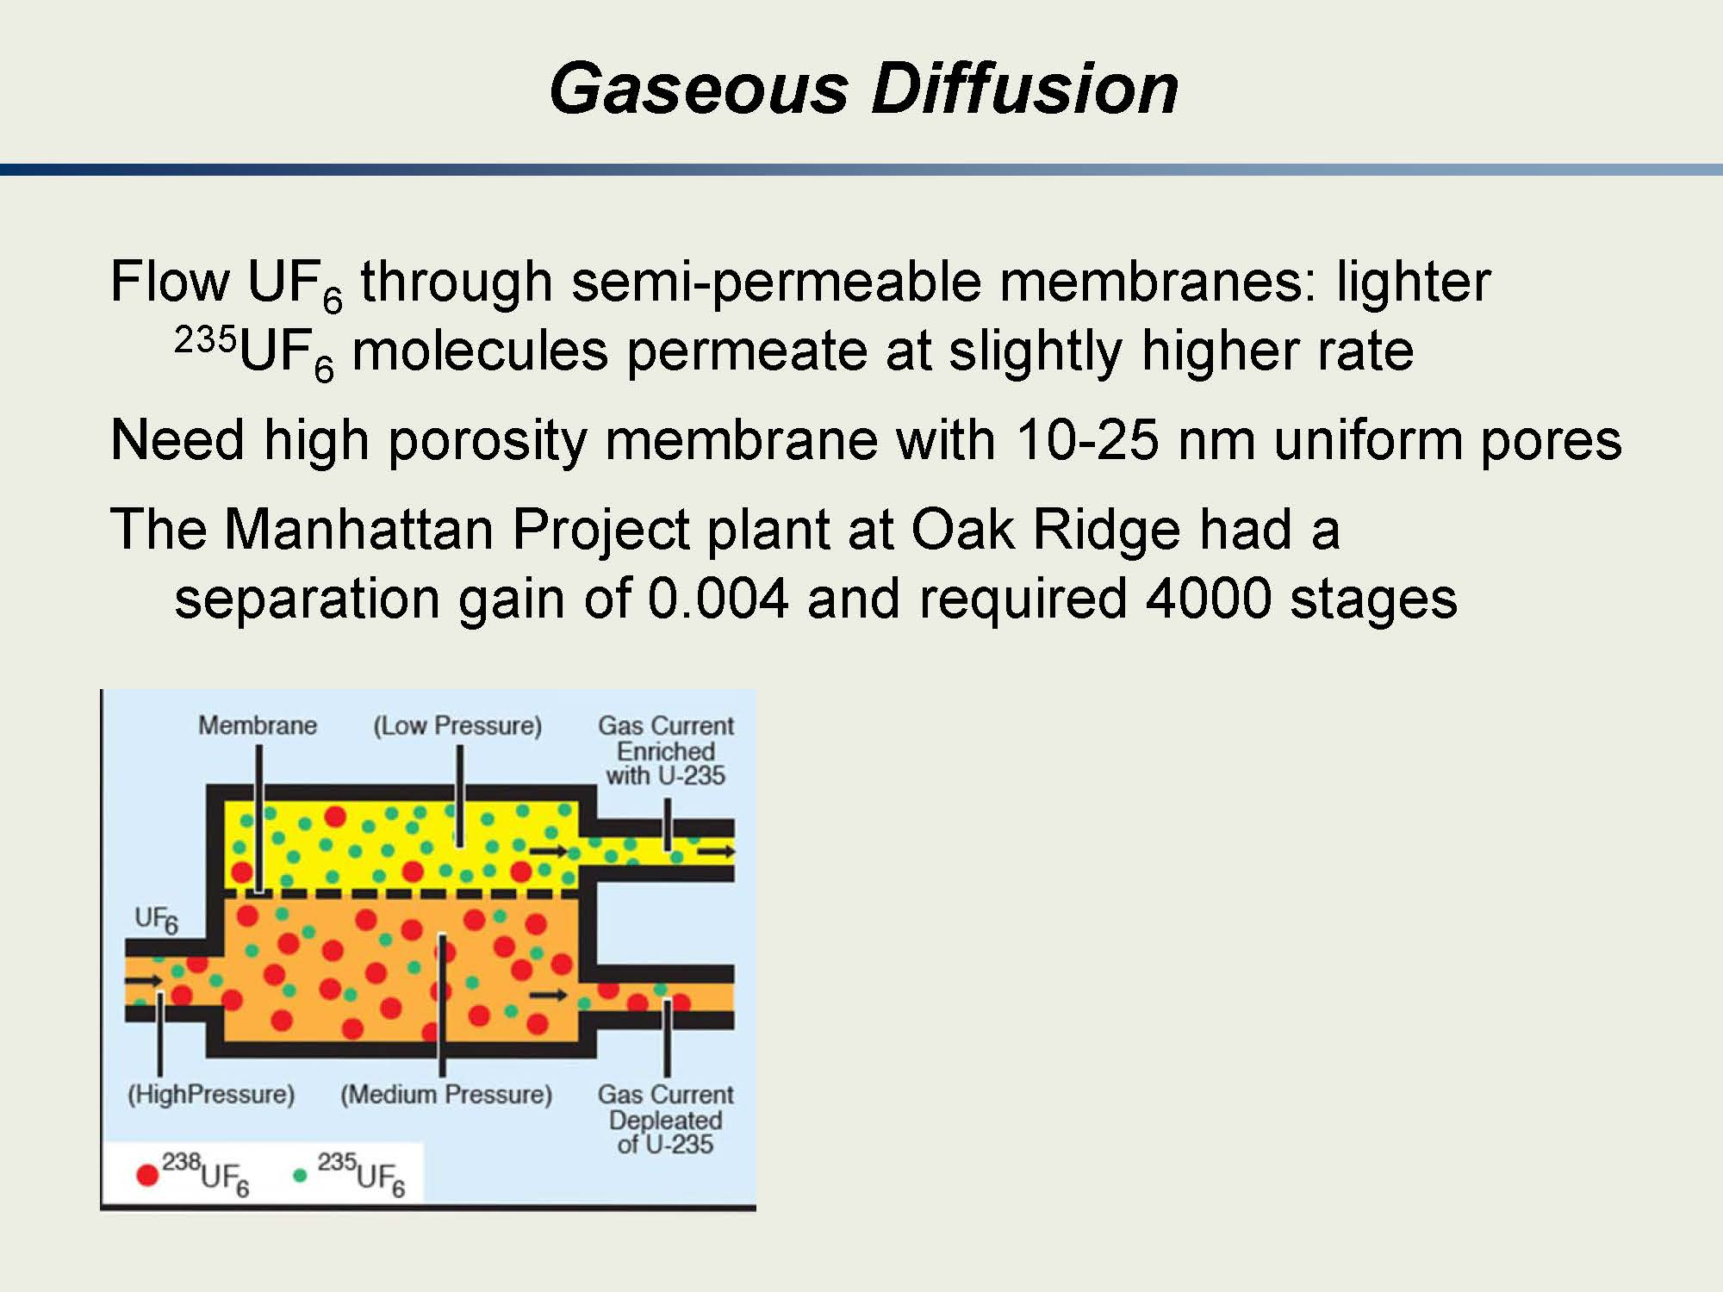

Slide 23
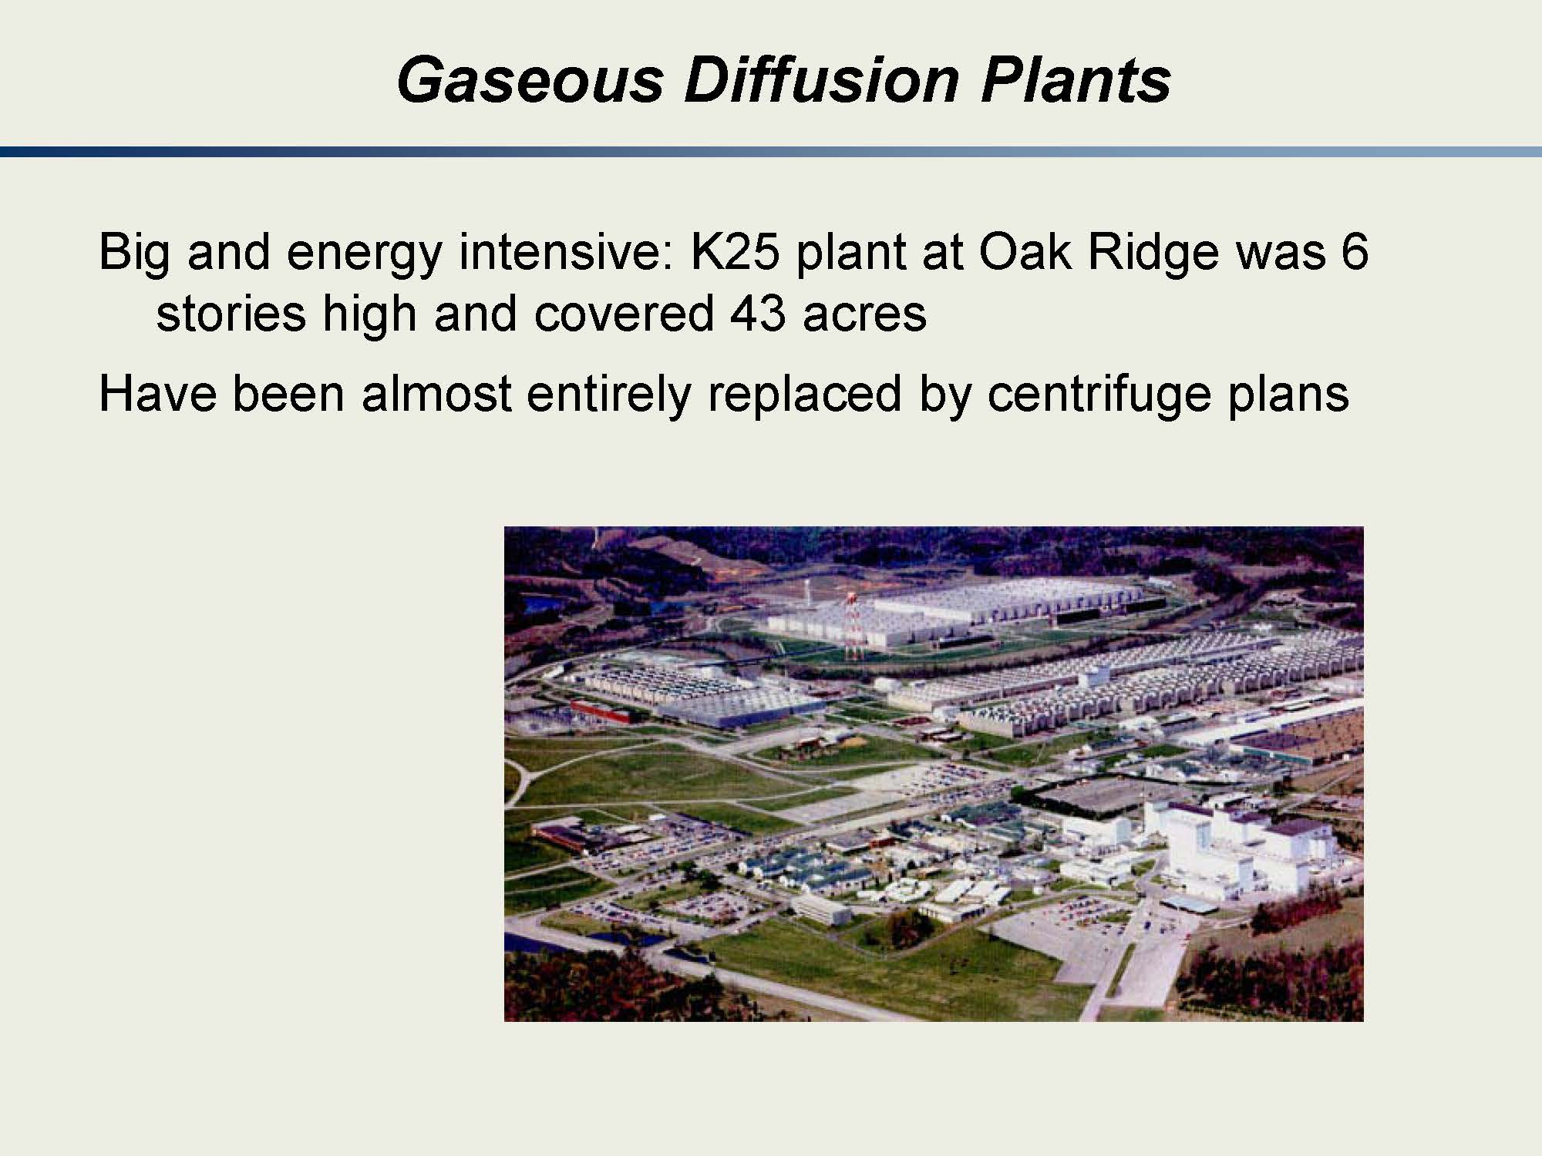

Slide 24
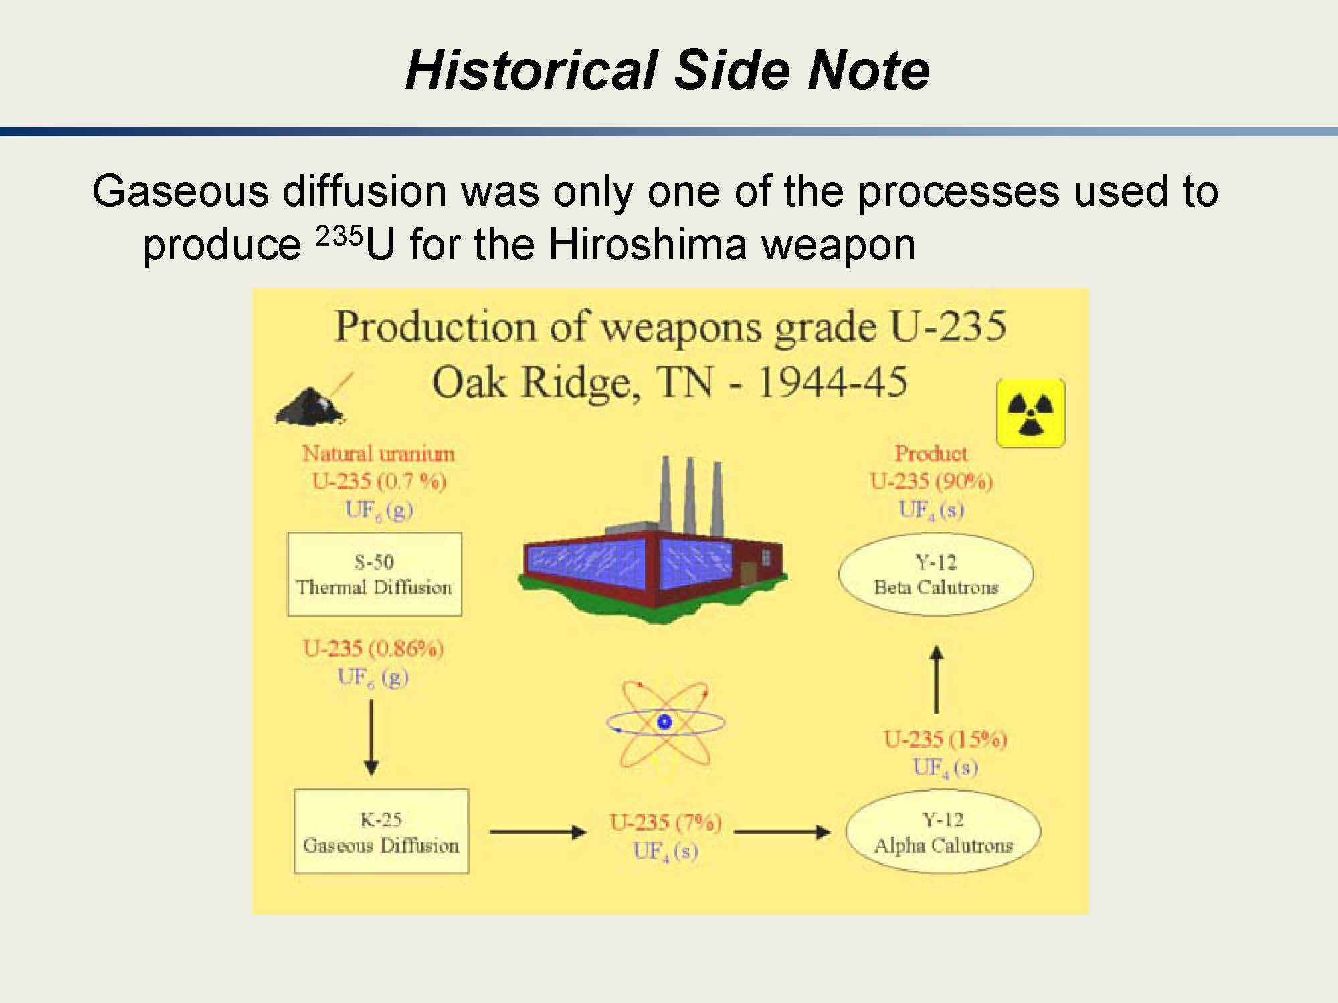

Slide 25
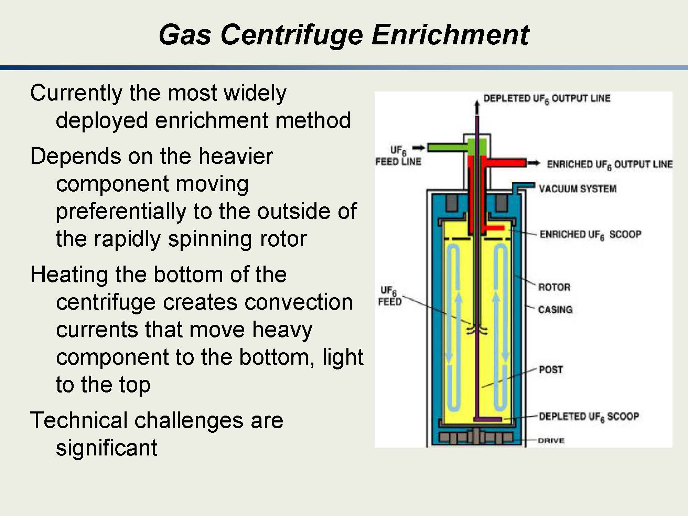

Slide 26
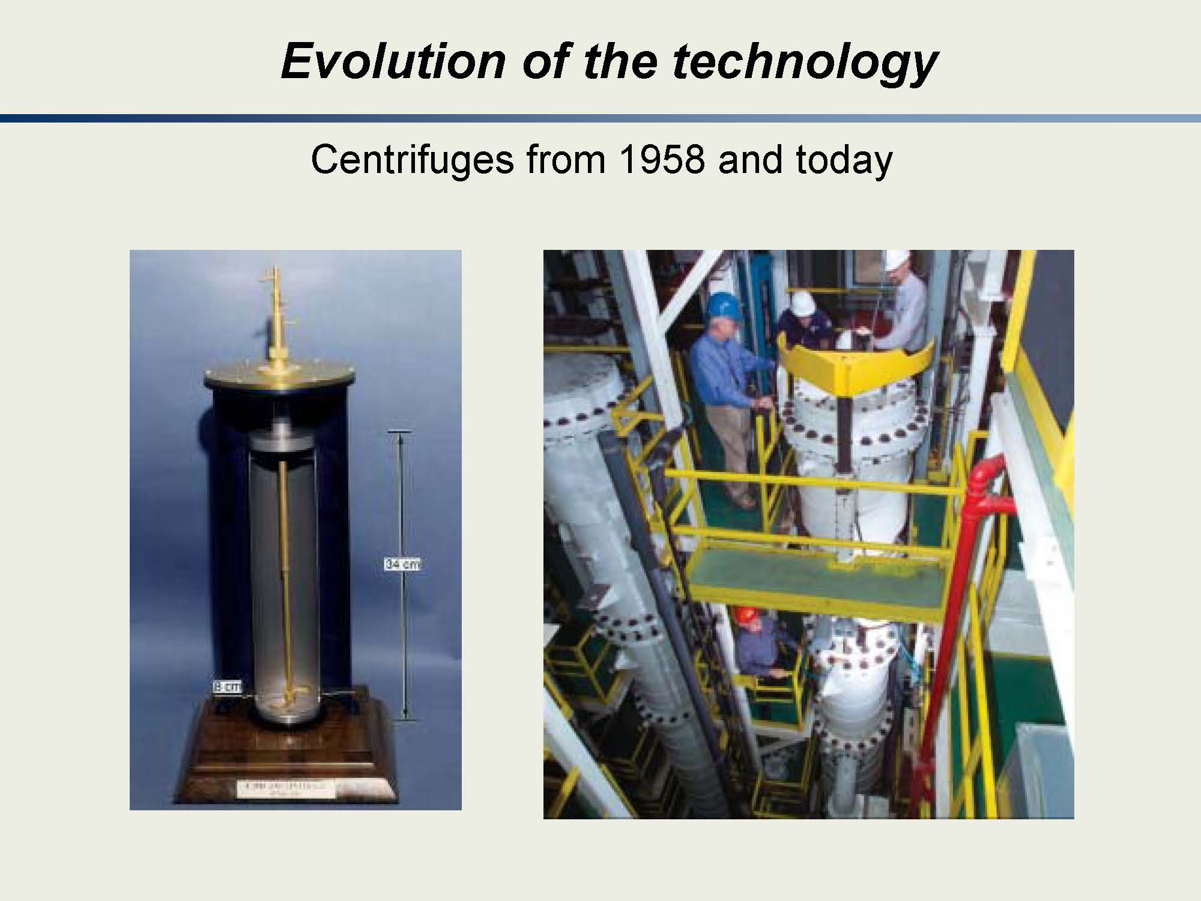

Slide 27
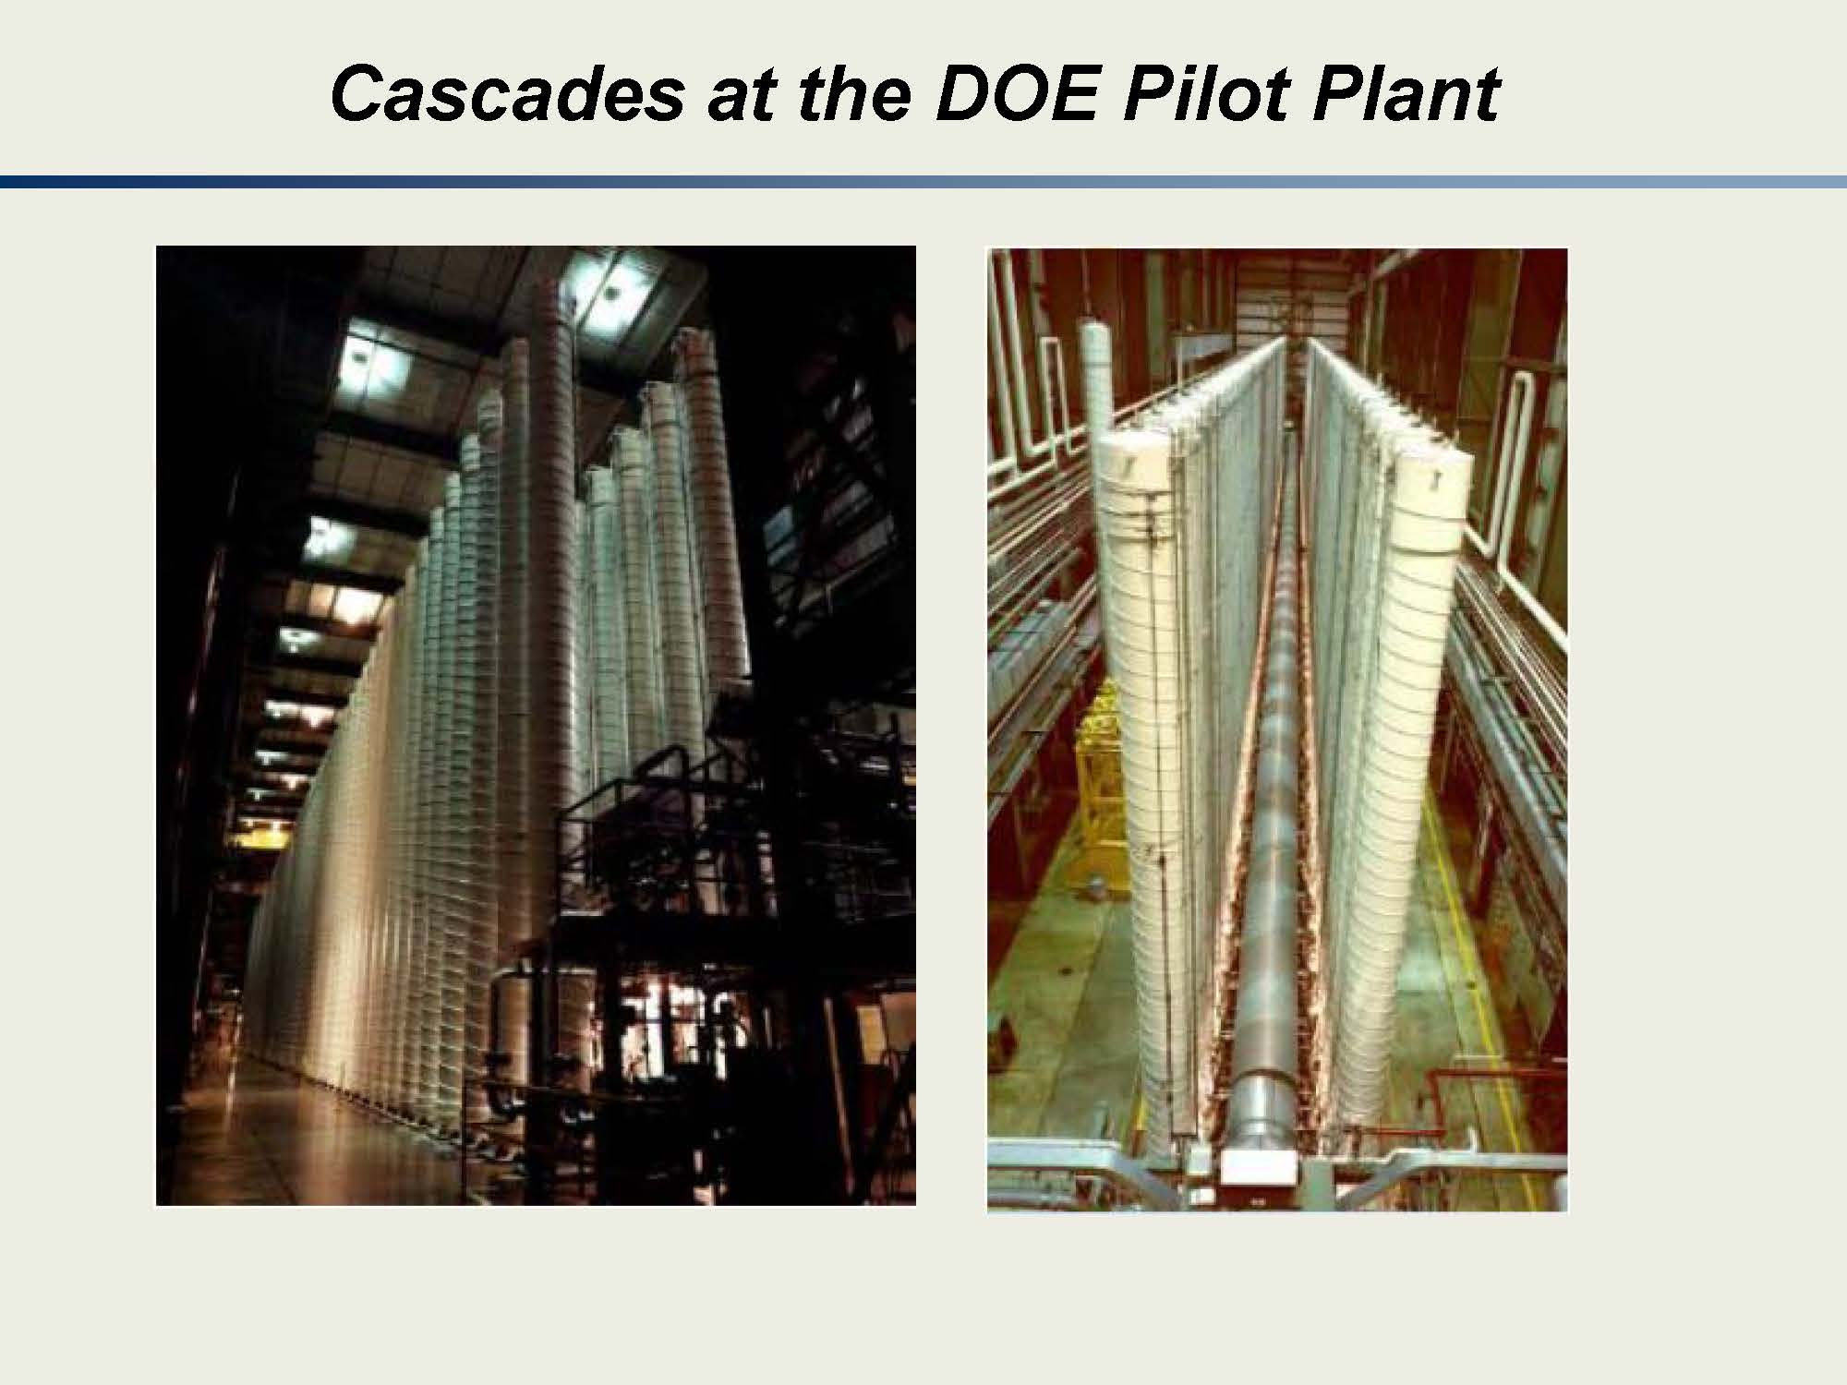

Slide 28
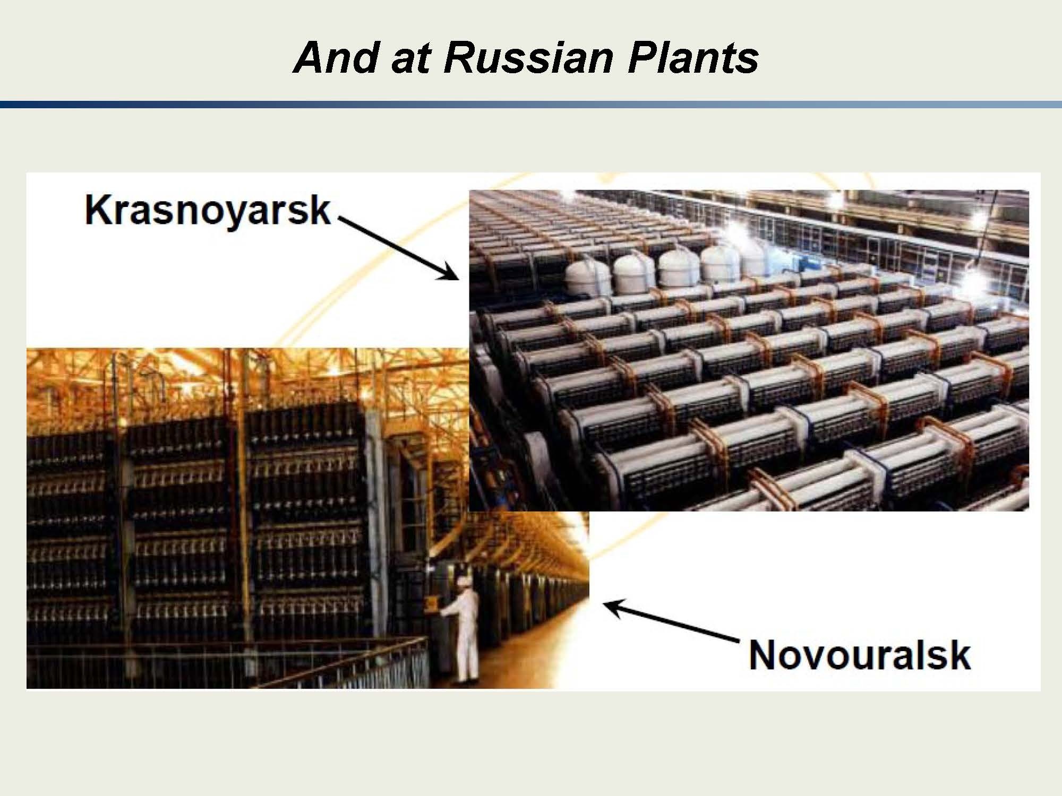

Slide 29
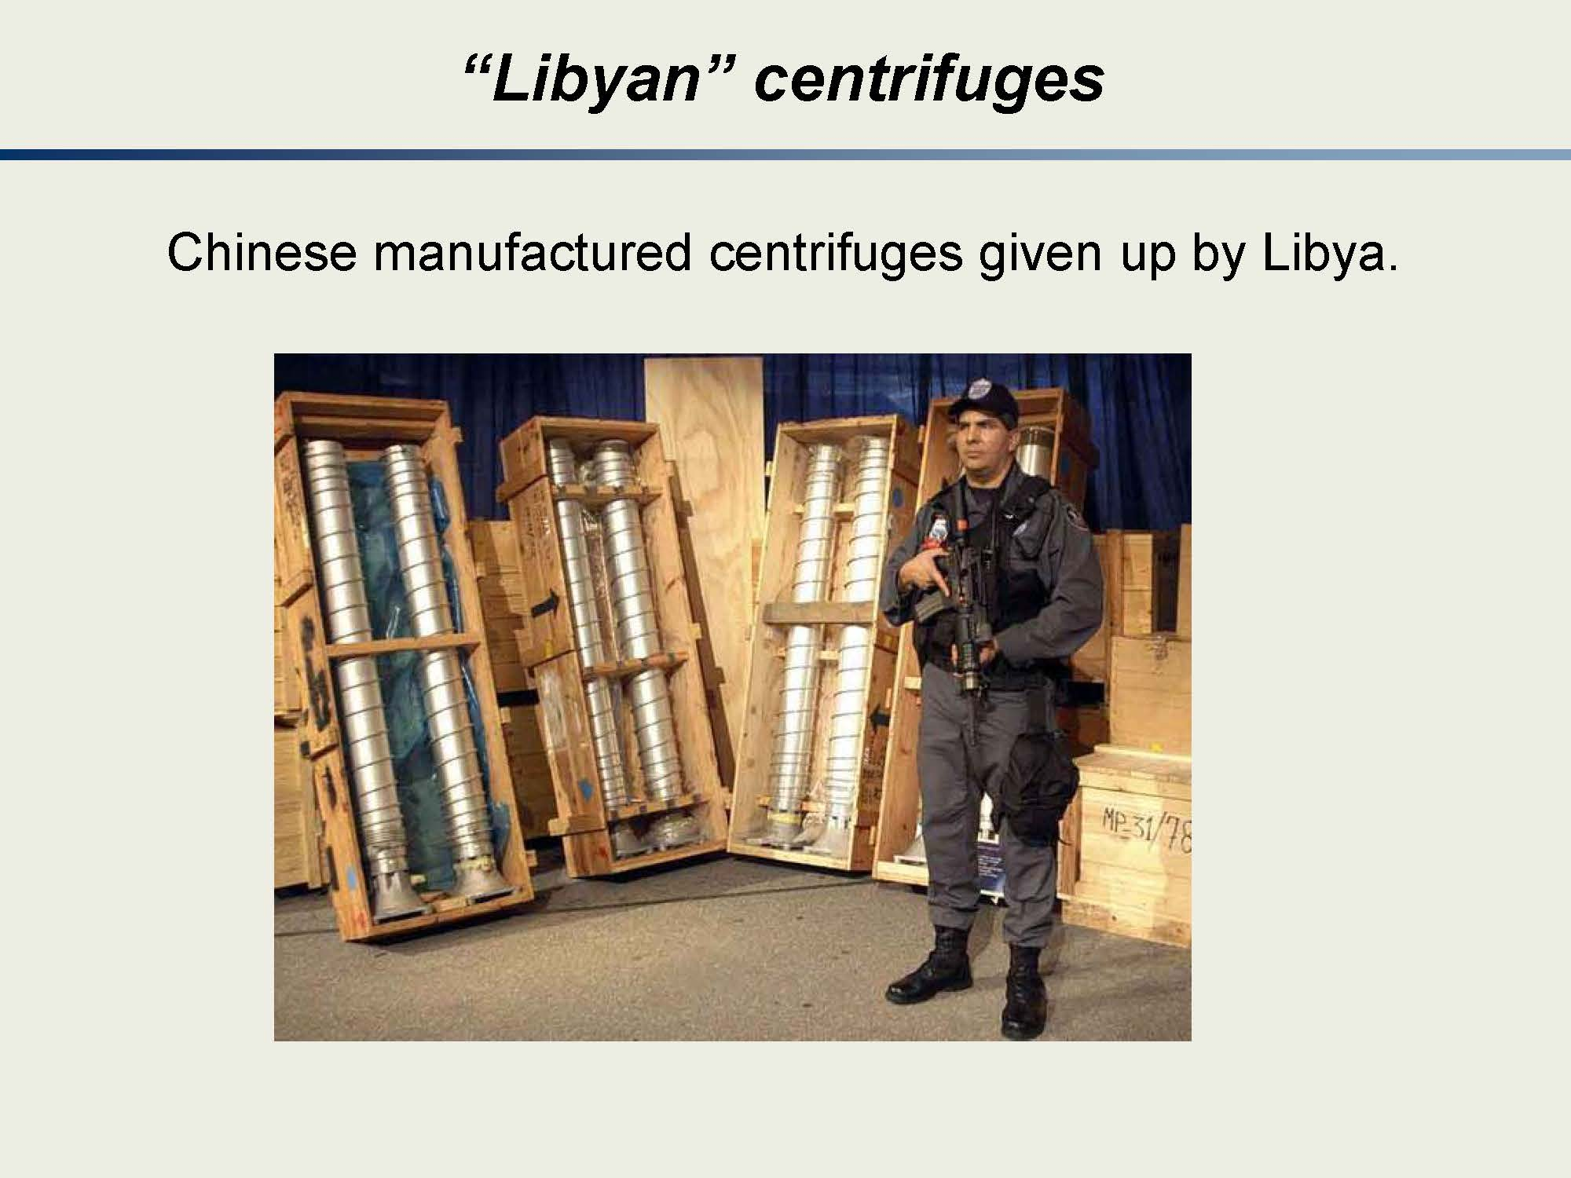

Slide 30
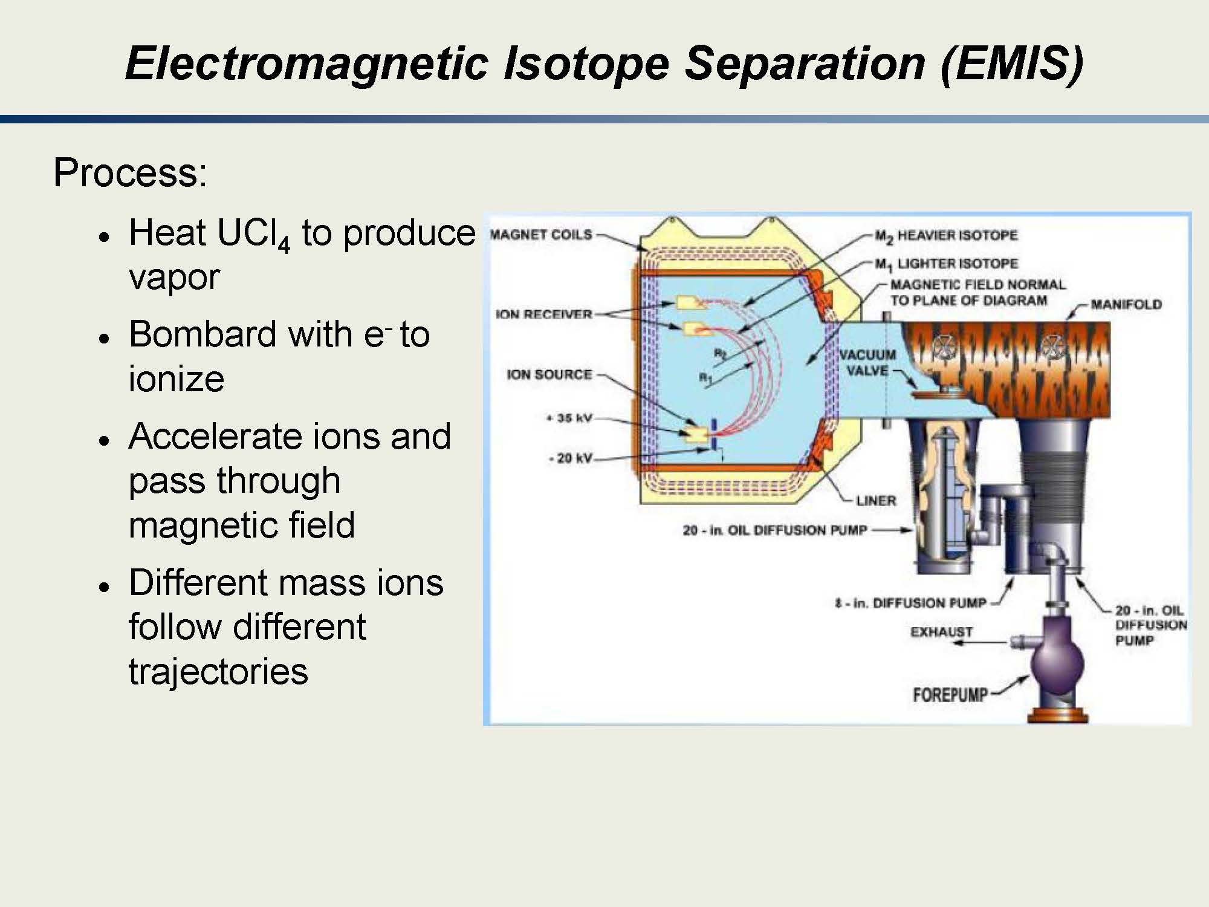

Slide 31
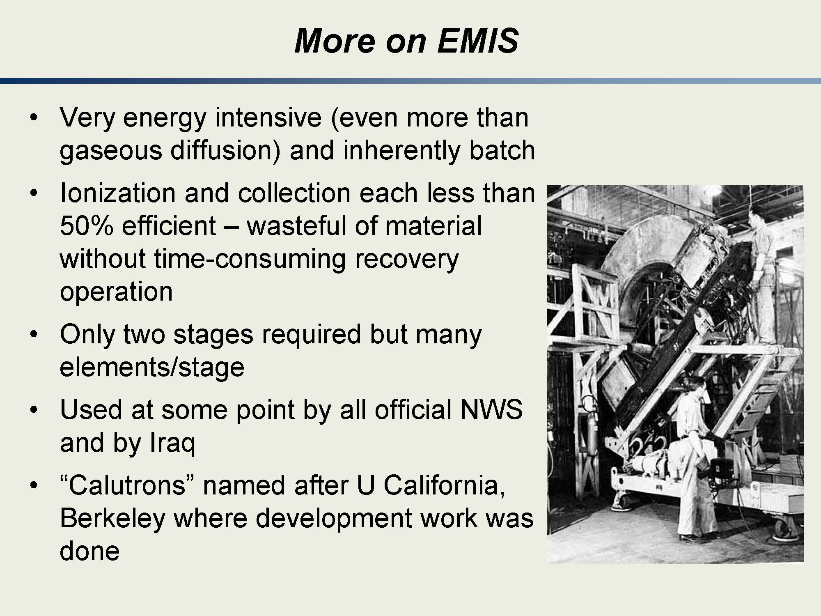

Slide 32
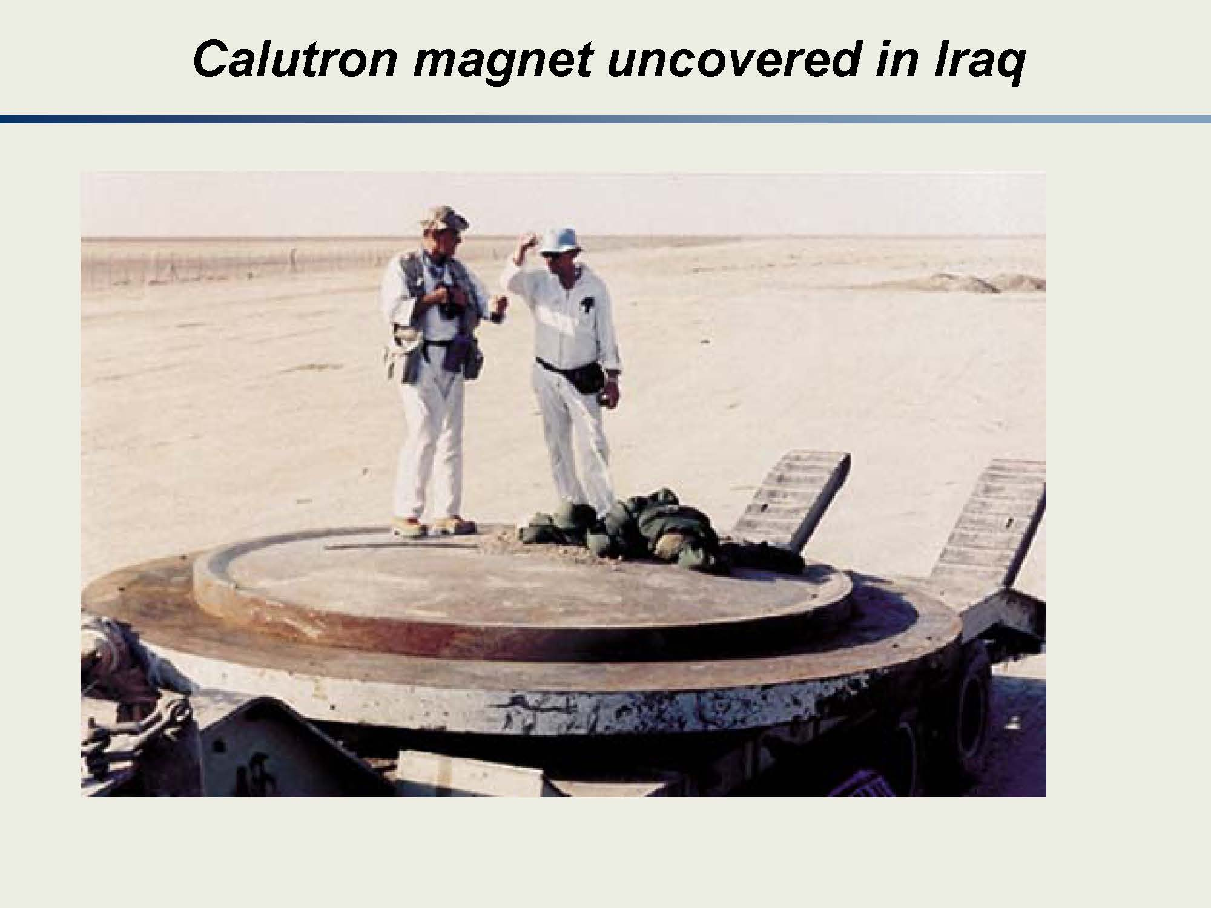

Slide 33
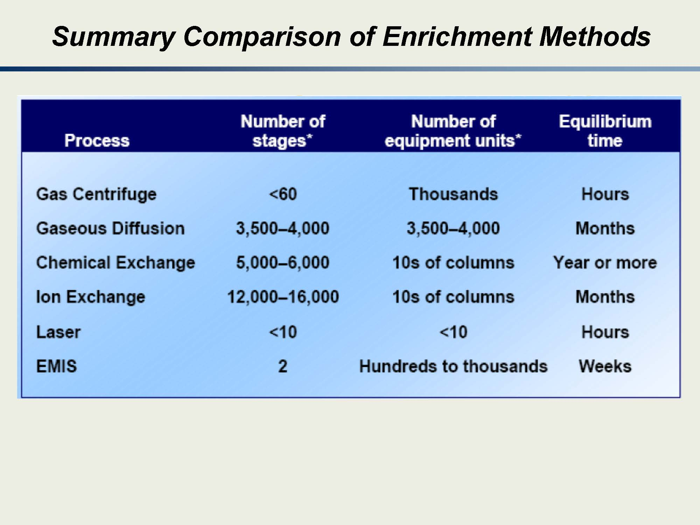
Notes:
Note here the differences between the various enrichment techniques.
The “why” behind each of the columns will become apparent in the subsequent lecture.
I should point out the “equilibrium time” is important. For example, if you have a dormant chemical exchange plant and want to turn it on, you will not produce HEU next week. If you have a LIS facility you could turn this on and very quickly begin to enrich HEU. Thus, the type of facility certainly plays a role in how quickly someone can create HEU.
It should also be noted that these times were developed based on a natural U feed. If you have a feed that is not natural U you can certainly decrease the time to enrichment.

Slide 34
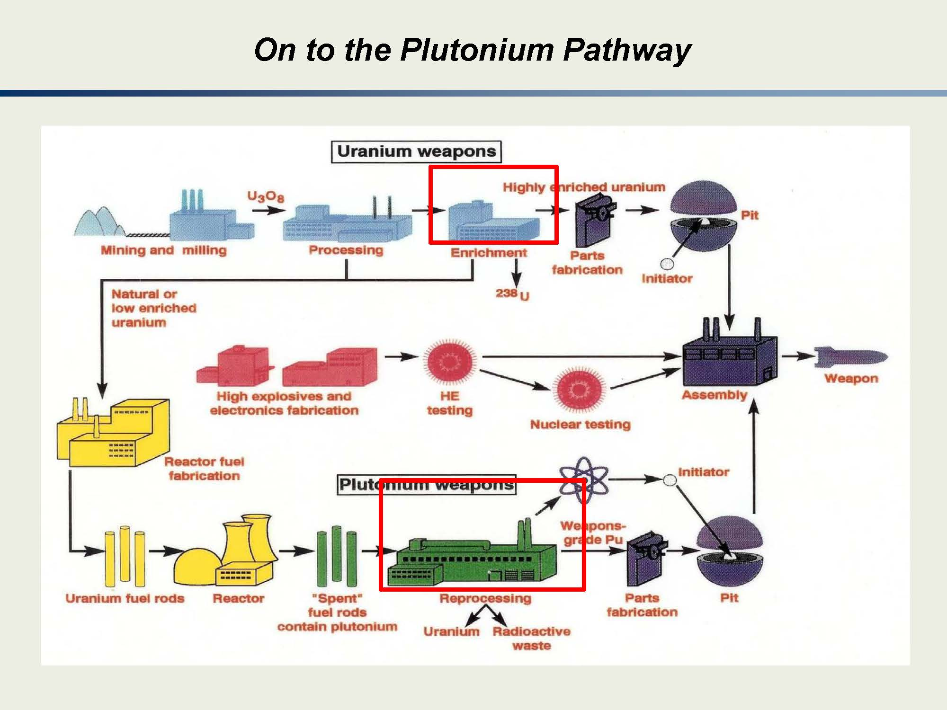
Notes:
What separates the Pu pathway from HEU is (interestingly!) separation! You have to REPROCESS fuel to get Pu.
It does not occur in significant quantities in nature.
This is one of the reasons why we are suspicious of anyone (who is not our close ally) who wants to do reprocessing.
Also, since you can do online refueling in CANDU (heavy water, natural U reactors) we think of these reactors as being a proliferation risk.
You will learn more about the time frame for Pu production in a later lesson.
For now, it is sufficient to know that 239Pu comes from spent reactor fuel. The longer the fuel resides in the reactor core the more higher Pu isotopes (240 and greater) are produced which makes reprocessing more difficult / challenging.

Slide 35
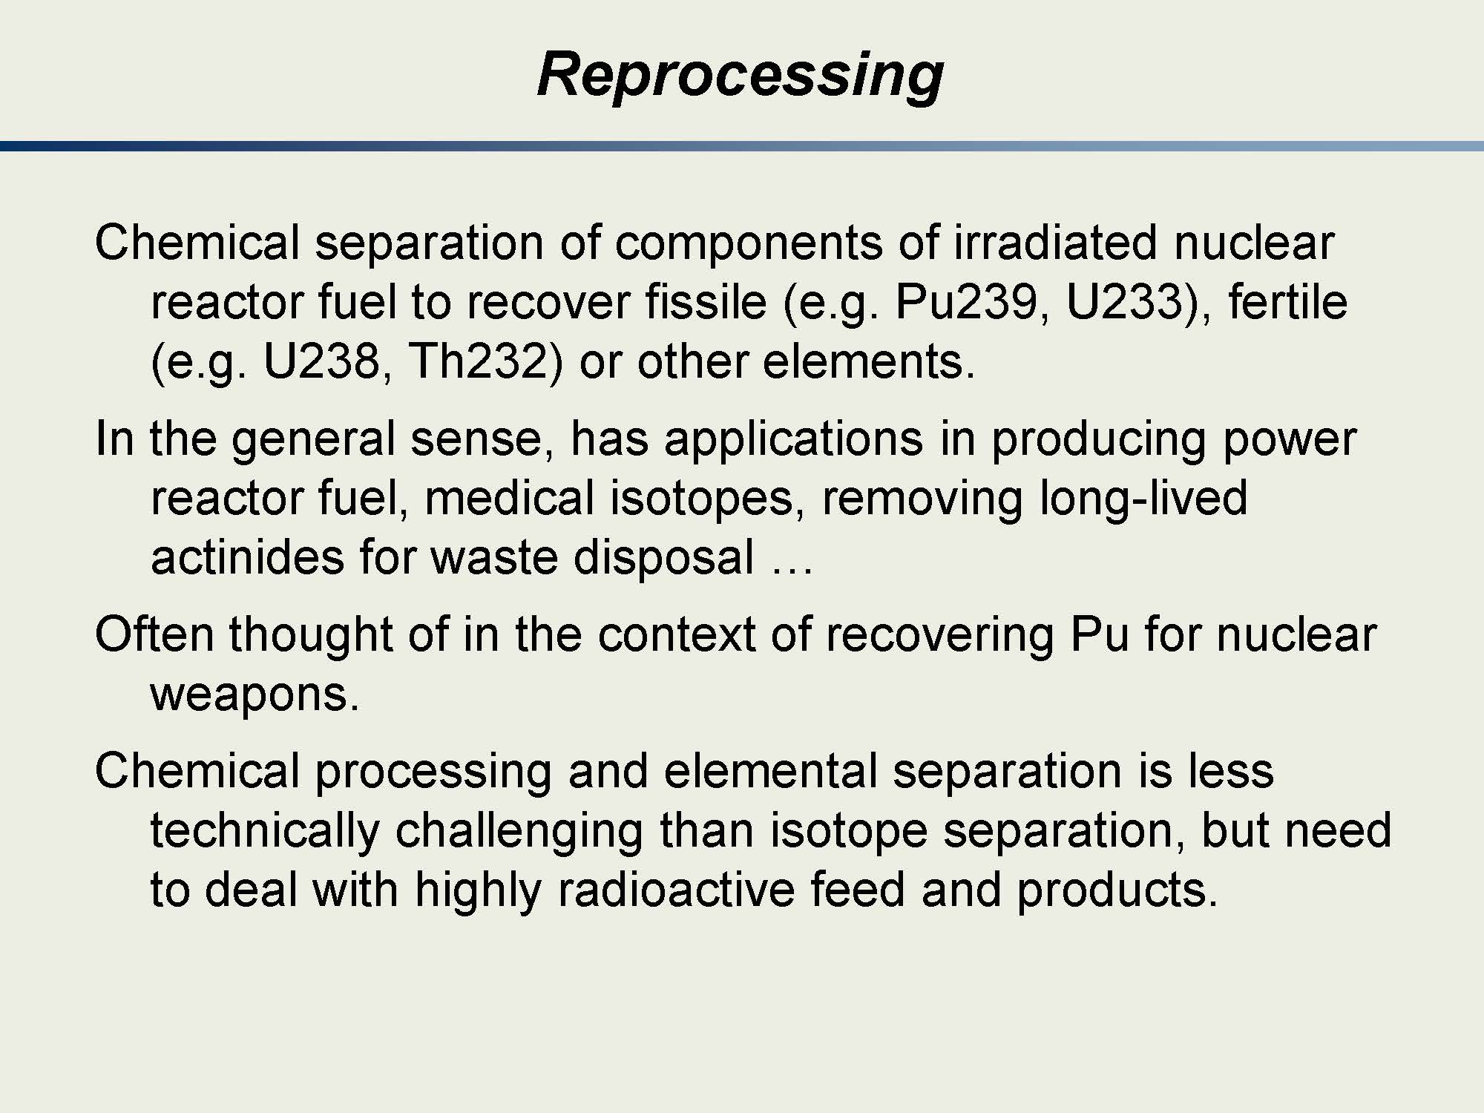
Notes:
The following slides provide a brief overview of the PUREX process.
I’ll cover these slides in more detail (hence why they are hidden here) but I provide them for you to get a preview of what is to come.

Slide 36
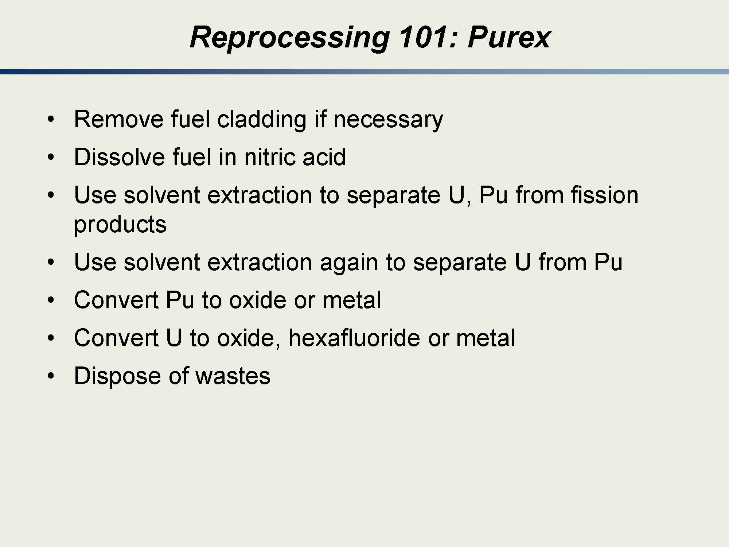
Notes:
(1) take the fuel and put it in a form you can use it
(2) Dissolve in nitric acid so you can
(3) separate most of the fission products from the desirable fissile / fertile material.
(4) Use solvent extraction to separate the U from Pu
(5) Convert the Pu and U into forms needed for your next step
(6) get rid of the waste

Slide 37
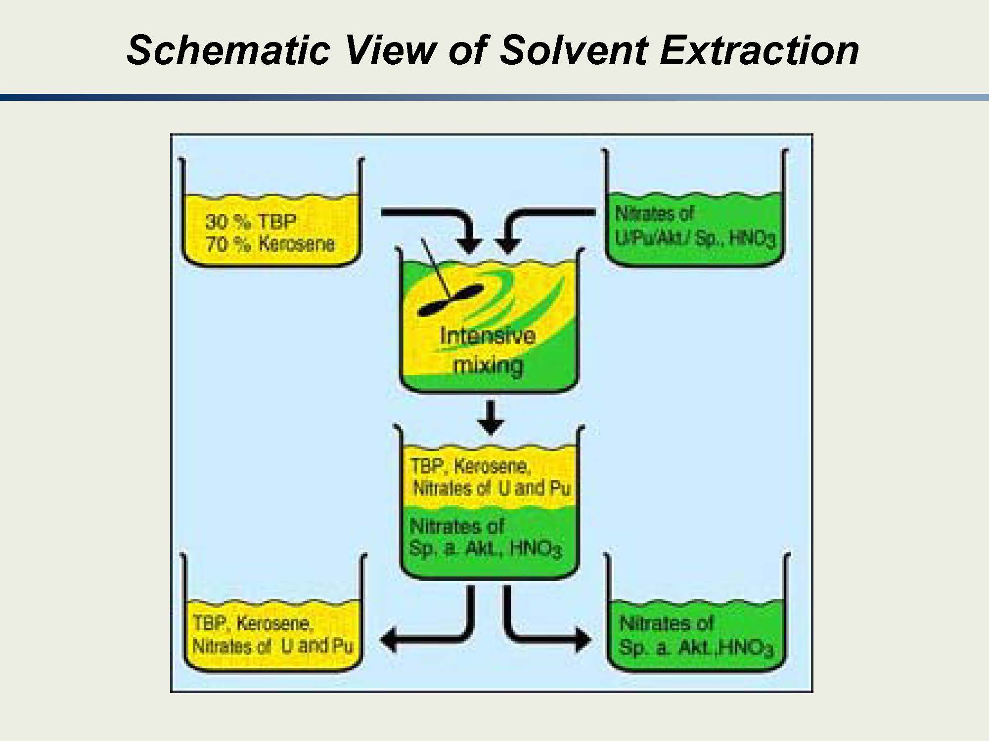
Notes:
Top right—put in form needed
Center top—mix
Center bottom—based on the chemistry, the U and Pu separate from most other things
Bottom left—U and Pu is separated
Bottom right—the “stuff” that we “don’t’ want”

Slide 38
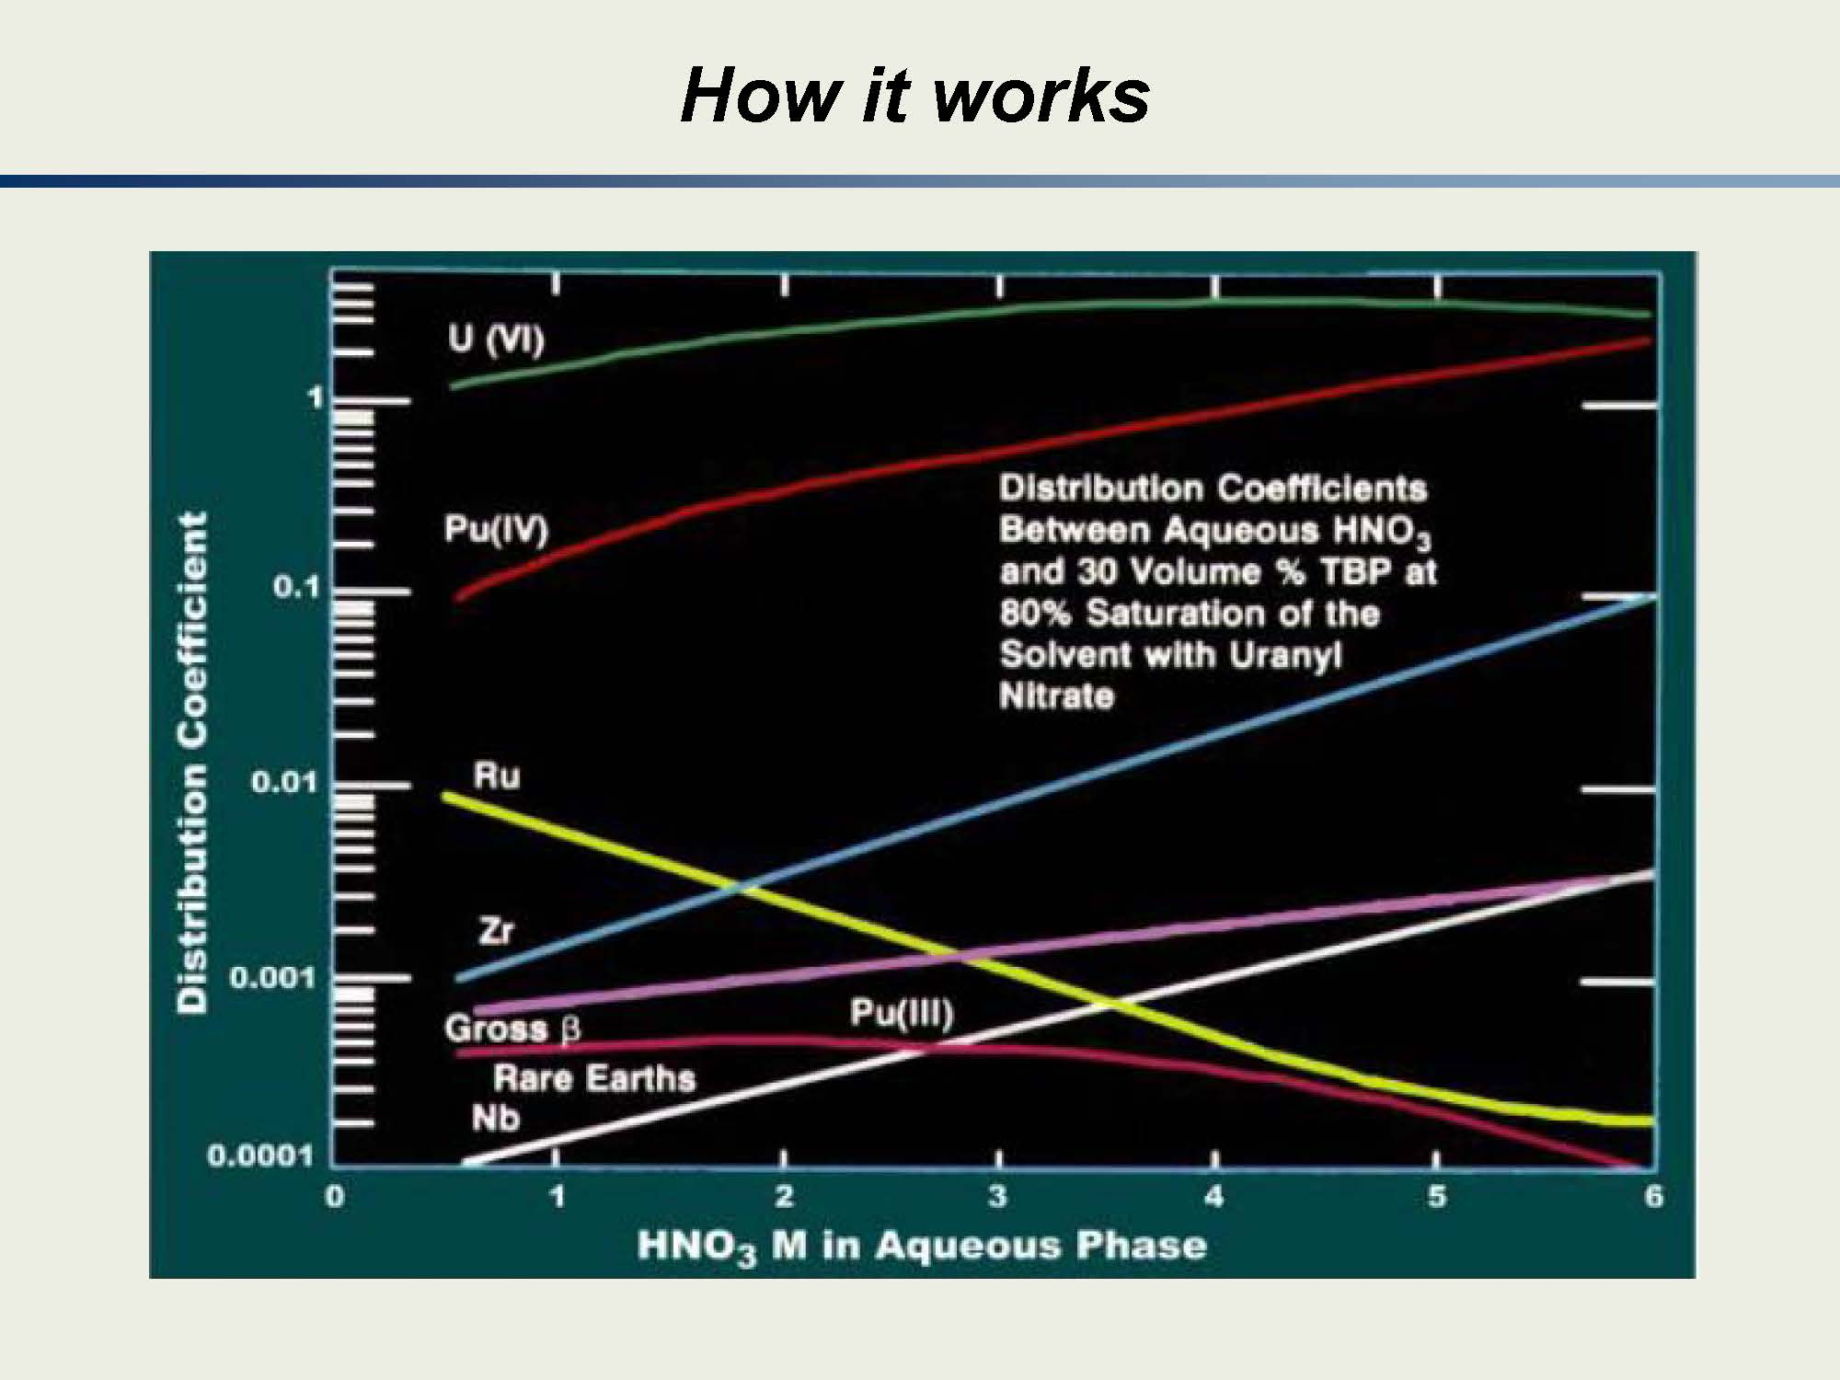
Notes:
The U and Pu prefer to go to the TBP

Slide 39
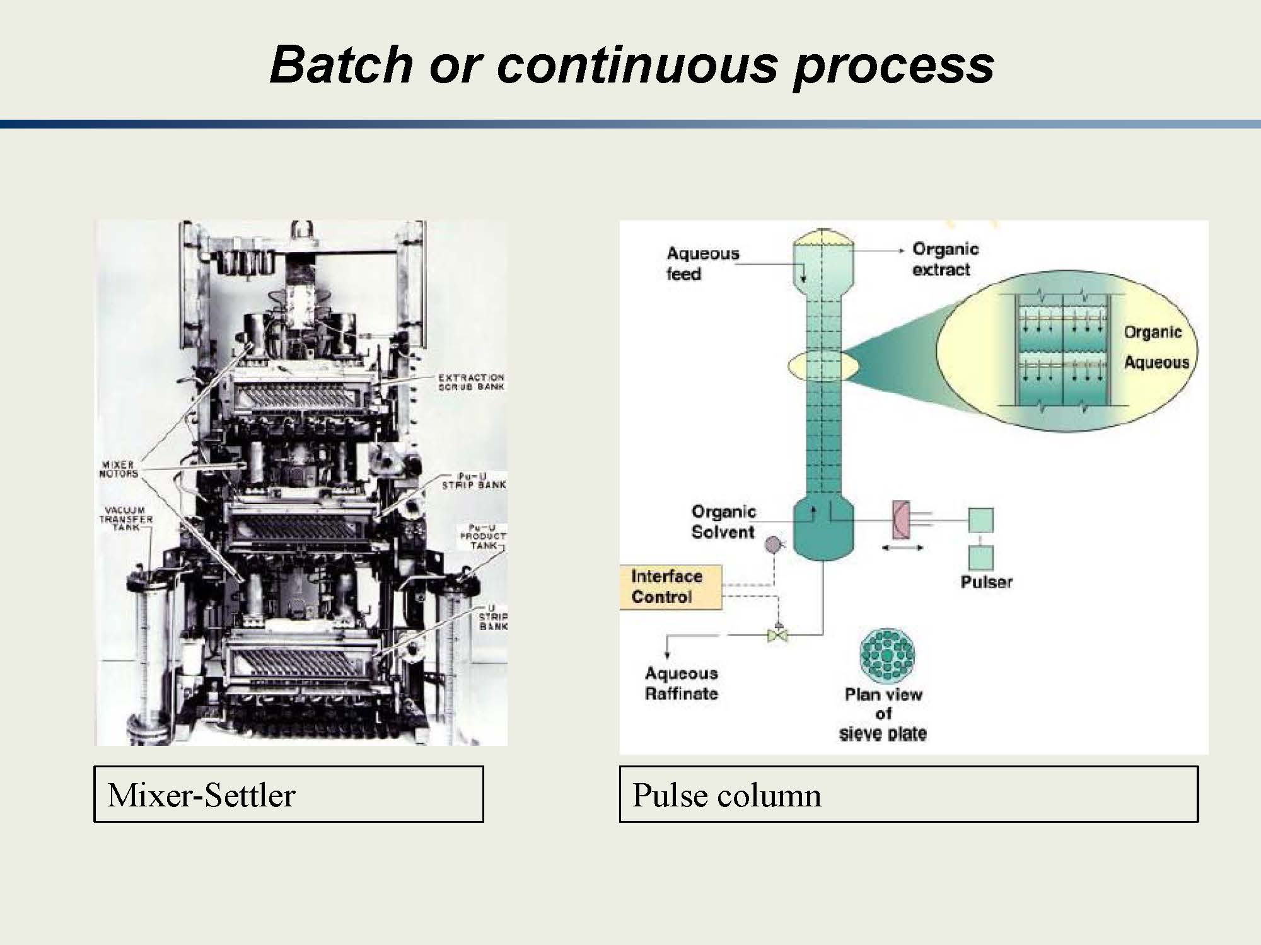
Notes:
Mixer—puts the solution (with everything) with the TBP/Kerosene and mixes so that the Pu and U will be “driven” into the TBP/Kerosene
Settler—allow them to separate so you have the Pu and U in the TBP/Kerosene

Slide 40
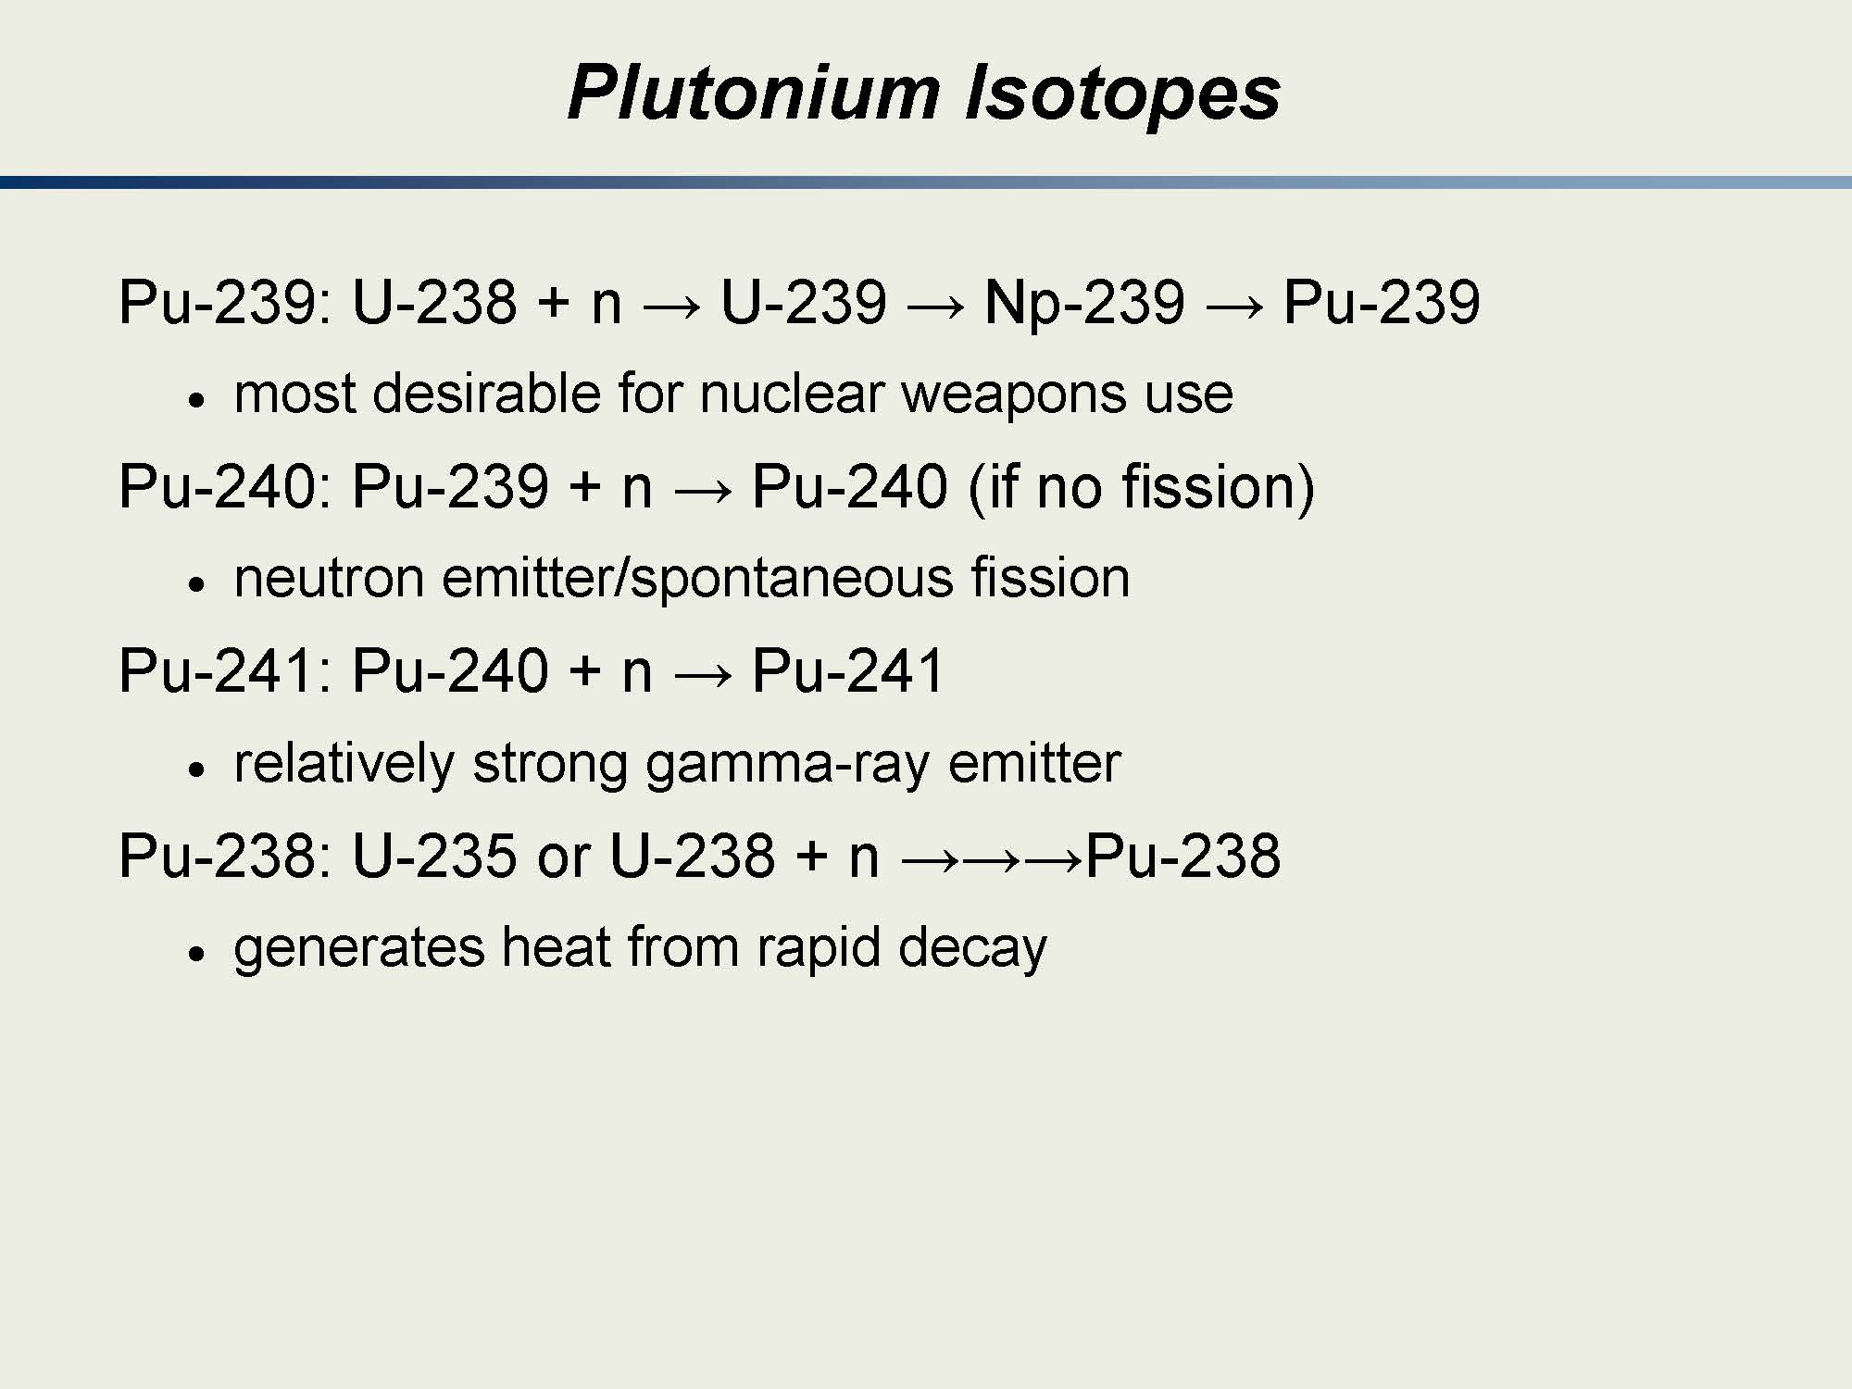
Notes:
We’ll go over these in more detail.
The main point is that for a Pu weapon, you want to maximize Pu239 and minimize the higher isotopes.
Note that doesn’t mean you can’t make a weapon if you have the other isotopes. Having a lower fraction of other isotopes makes the process that much easier.

Slide 41
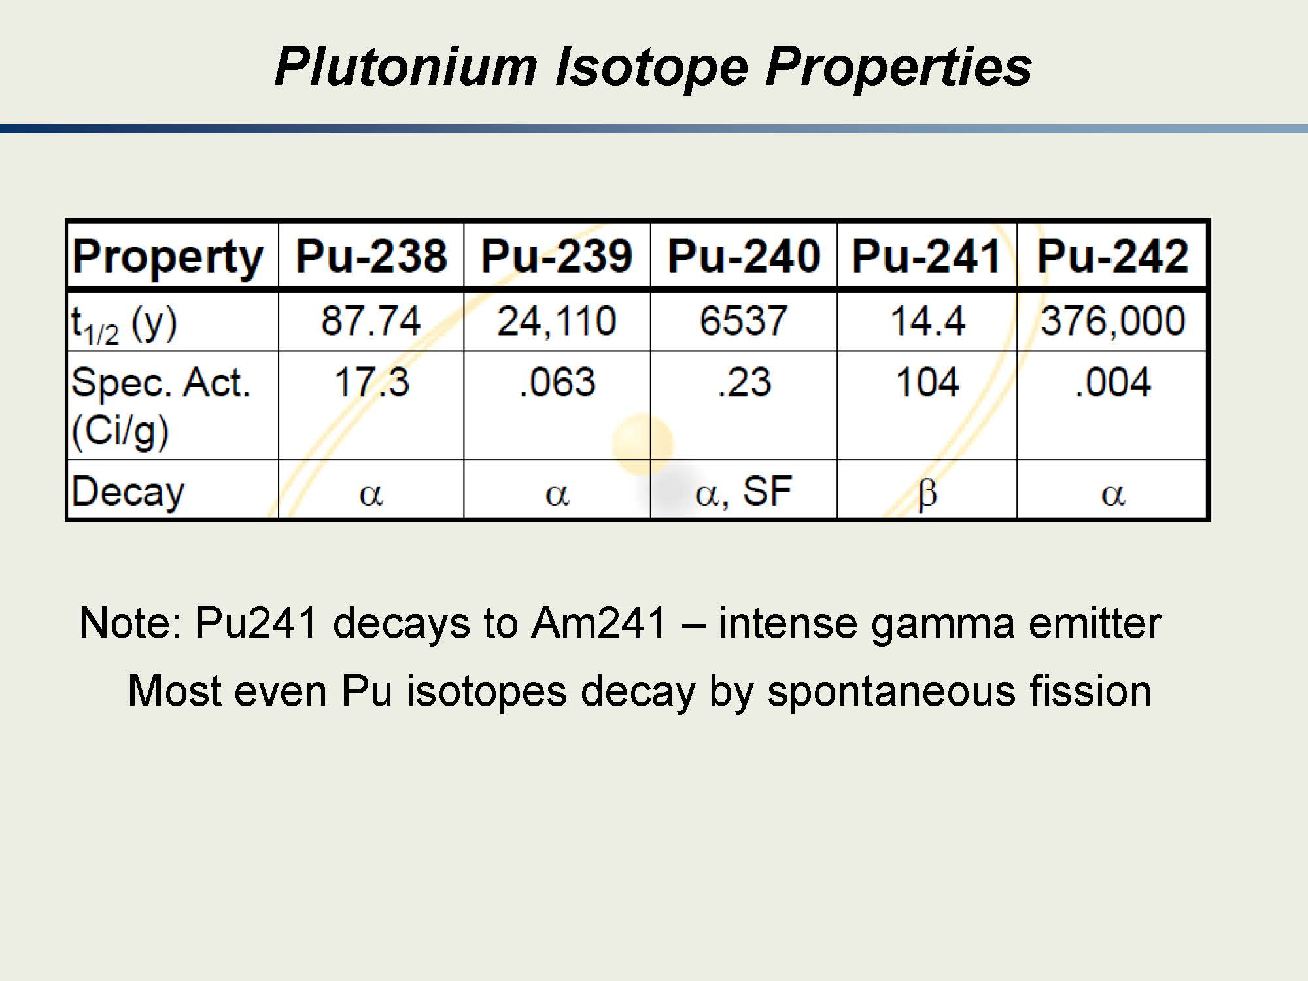

Slide 42
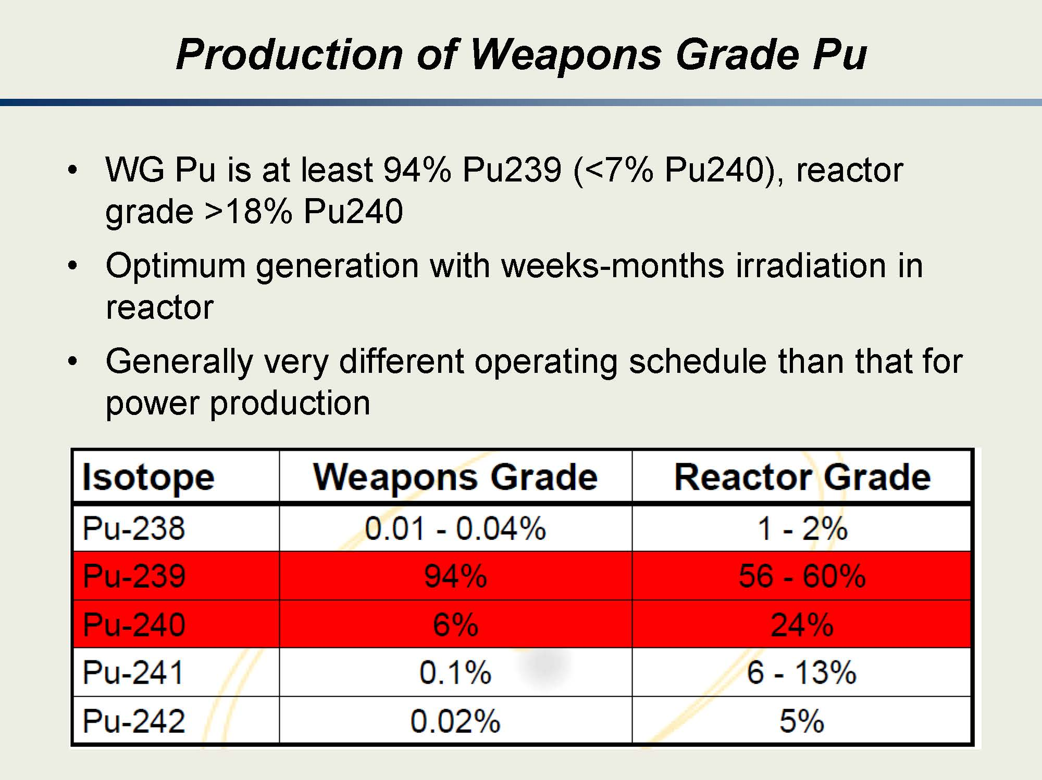

Slide 43
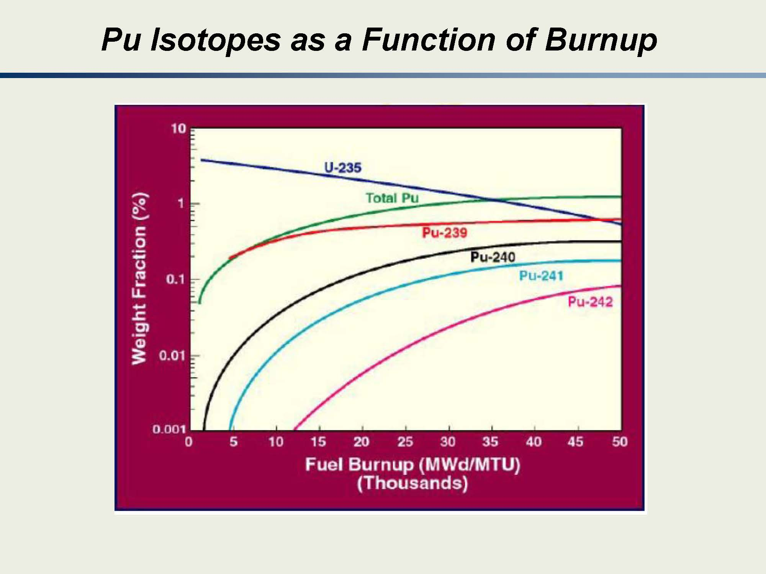

Slide 44
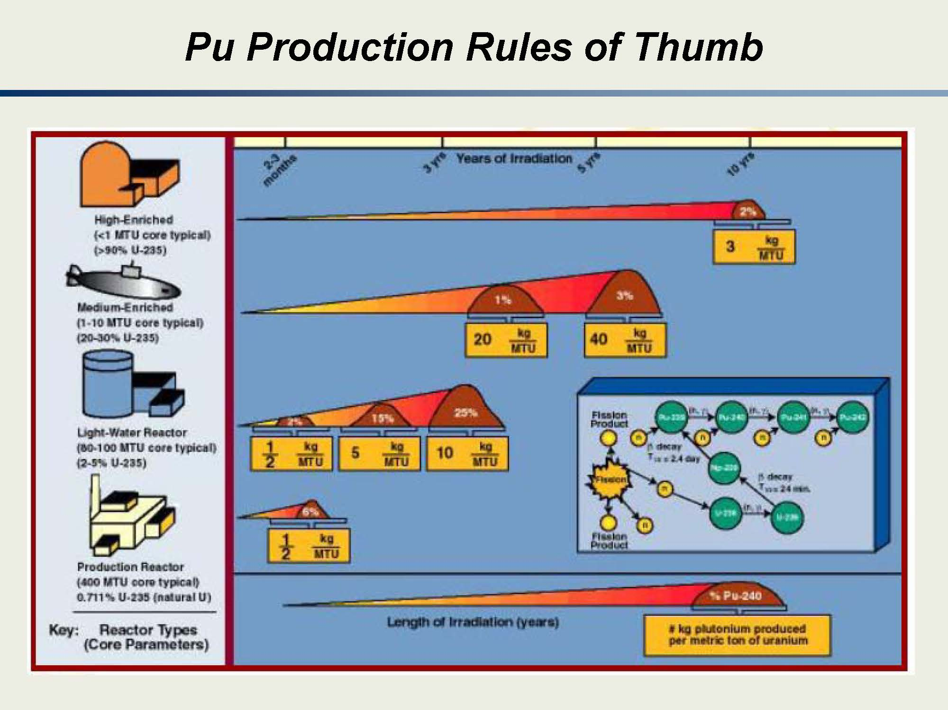

Slide 45
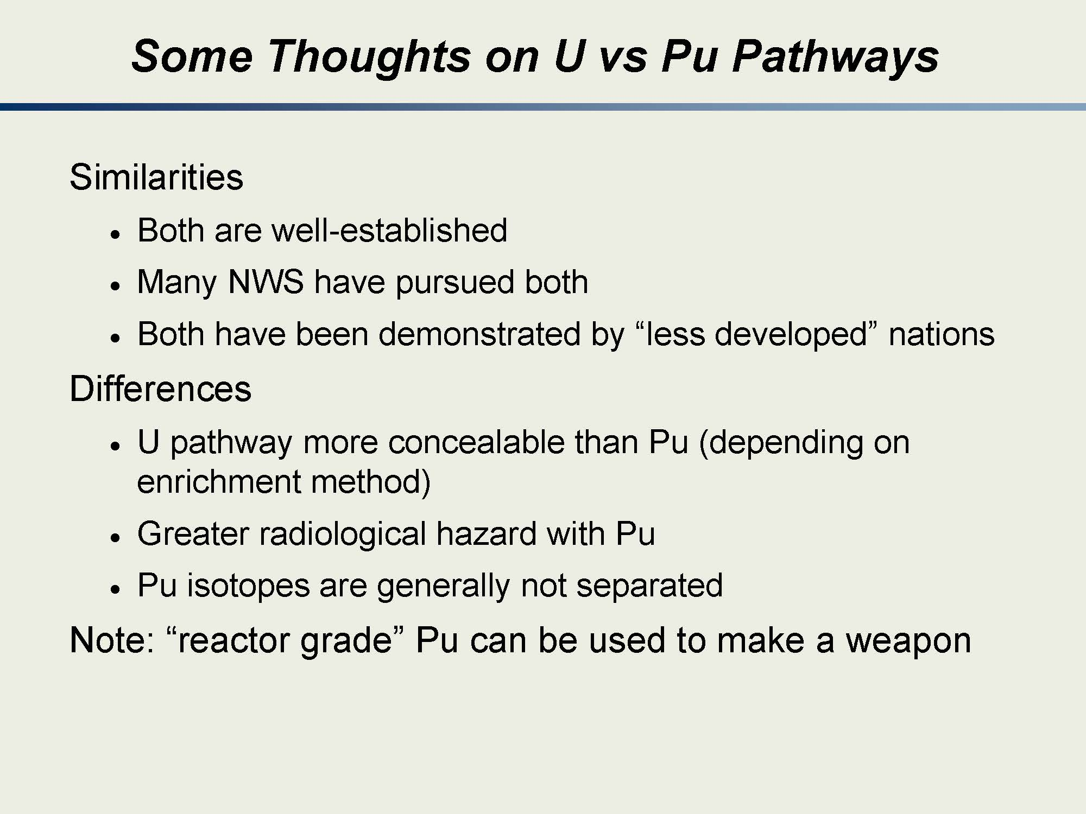
Notes:
We’ll learn more about the similarities and differences in the next two blocks.
Key points are
(1) It’s been done. We did it in the 1940s so there are many, many states that have the capability to do what we did.
(2) 235U enrichment is really just basic physics. There are some technical barriers but they are not insurmountable.
(3) Working with fuel that has been through a reactor is a lot more difficult than working with natural and enriched U that hasn’t….

Slide 46
Do you understand? Can you explain? Can you estimate?
(1) Can you describe the civilian nuclear fuel cycle?
(2) Can you describe the Fuel Cycle and Proliferation Pathways?
(3) How do two enrichment facilities rated for the same number of SWUs end up with very different enrichment results?
(4) How many SWU fuels are needed for a 1 GW(e) LWR for one year?
(5) How many SWU to produce 1 kg of 90% HEU from ~ 200 kg of natural Uranium?
(6) What is a stage and a cascade? What are their functions?
(7) Can you describe the similarities and differences of the U and Pu pathways?

